Slide 1
RAPID-First Steps Kent
Data Briefing – Ongoing Assessment 4
August 29th, 2023

Slide 2
RAPID-FSK Survey Responses
3,358 valid responses from 1,822 parents!
Responses in Each Survey
Survey | n | Dates
Initial Recruitment 1 | 492 | 4/20 – 5/06
Initial Recruitment 2 | 170 | 7/12 – 7/26
Ongoing Assessment 1 | 222 | 7/12 – 7/27
Initial Recruitment 3 | 49 | 10/04 – 10/20
Ongoing Assessment 2 | 124 | 11/02 – 11/13
Initial Recruitment 4 | 579 | 12/05 – 1/04
Ongoing Assessment 3 | 480 | 2/13 – 2/26
Initial Recruitment 5 | 475 | 4/17 – 5/01
Ongoing Assessment 4 | 762 | 5/17 – 5/30

Slide 3
RAPID-Fsk current Participant Demographics (n = 1,822)
Race/Ethnicity
5.62% American Indian/Alaska Native (n = 101)
4.95% Asian (n = 89)
14.91% Black (n = 268)
11.63% Hispanic/Latinx (n = 209)
5.12% Native Hawaiian/Pacific Islander (n = 92)
56.93%% White (n = 1,023)
0.11% Other Races (n = 2)
Household Structure
7.61% single-parent households
8.48% households of children with disabilities
Community Types
55.98% Grand Rapids/Wyoming/Kentwood
4.33% Southeast Kent County
23.73% Northern Kent County
5.22% Southwest Kent County
10.75% Suburbs
Income Levels
35.06% below 200% FPL
58.11% between 200% - 400% FPL
6.82% above 400% FPL
Material Hardship Status
70.81% with hardship
29.19% no hardship

Slide 4
overview
Notable Findings
Persistent High Level of Material Hardship
Child Behavioral Problems
Increased Concerns About Children
Quotes from Parents
Special Focuses
Inflation
Summer Child Care
Receive Information & Participate in Programs (Service Module)

Slide 5
notable findings

Slide 6
1. Persistent High Level of Material Hardship

Slide 7
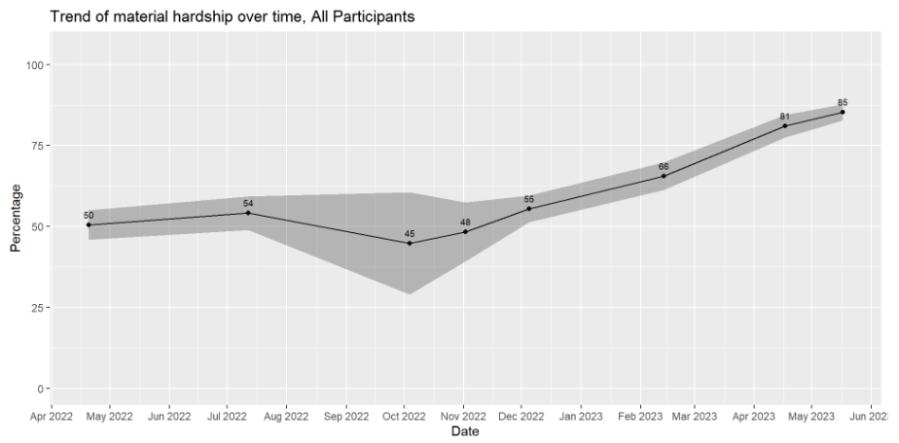
RAPID-FSk Survey: Material Hardship rate
Note: Material hardship is defined as having difficulty paying for at least 1 types of basic needs among: food, housing, utilities, childcare, healthcare, and social/emotional needs.
Notes:
Much higher

Slide 8
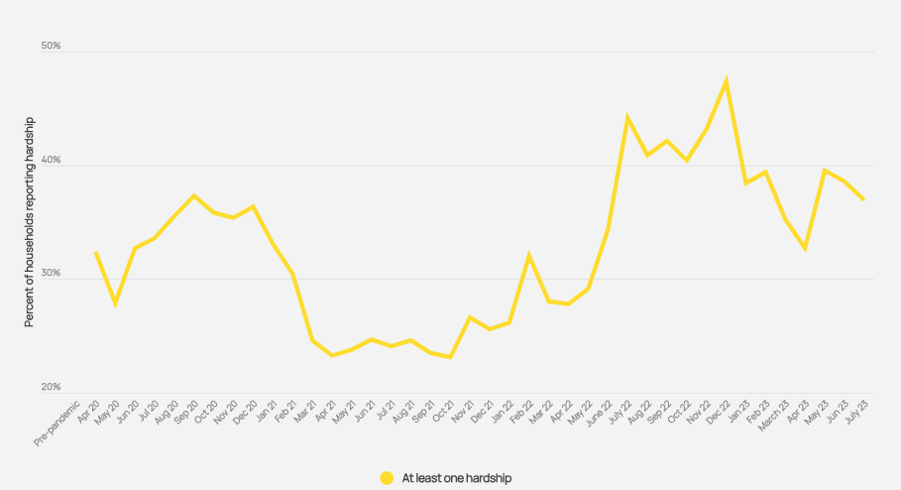
Comparison national survey material hardship rate
Notes:
Material hardship rate in Kent county is significantly higher than that in the national survey. In Kent, the rates throughout our survey period ranges from 45% to 85% and keep increasing. However, in national surveys, the rates during the same periods of time ranges from 28% to 47%, and the peak is in December 2022.

Slide 9
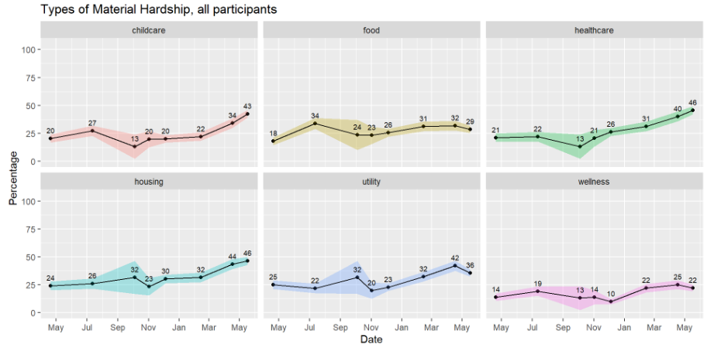
RAPID-Fsk Survey: Material Hardship types
Notes:
We see increasing trends of hardships particularly in child care, healthcare, housing, and utility costs.
In recent June survey, housing and healthcare hardships were the highest (46%), followed by child care hardship (43%), utilitiy (36%), food (29%), and wellness activities (22%)

Slide 10
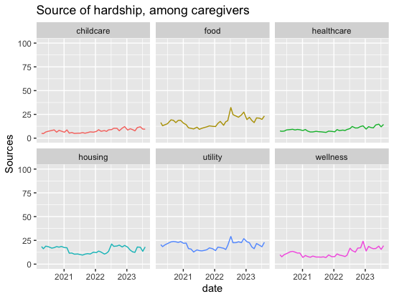
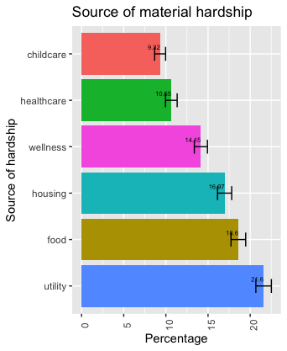
Comparison national survey Material Hardship types
Notes:
Compared with national data, Kent county has comparable hardship rates in the categories of food and wellness activities, but significant higher rates in all the other types of hardships.
Also notable difference in national surveys ranks: highest utility hardships, followed by food, housing, wellness, healthcare, and child care.

Slide 11
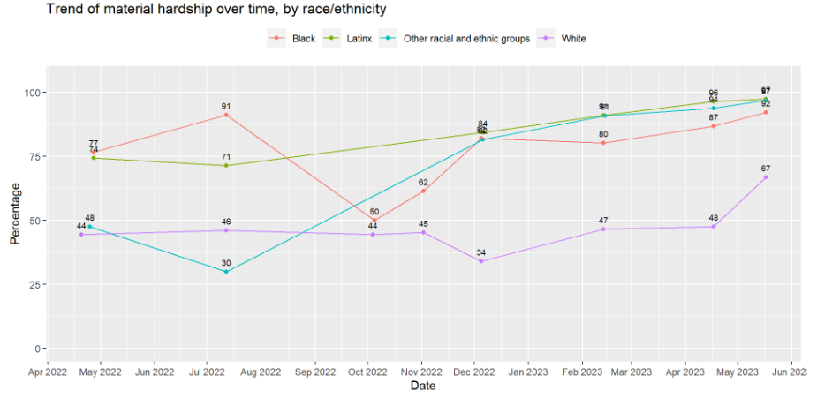
RAPID-FSk Survey: Material Hardship rate by race/ethnicity
Notes:
12 Other minorities – small sample
For reference, in national samples, recent hardship rates were around 60% for Black families, 50% for Latinx families, and 30% for White and other minority families.

Slide 12
2. Child Emotional Distress

Slide 13
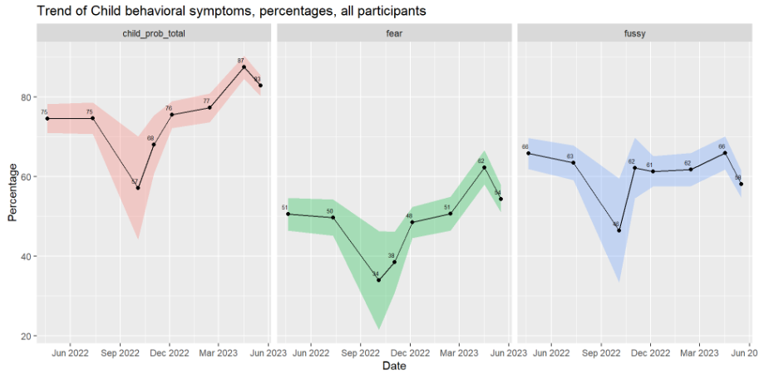
RAPID-fsk: child EMOTIONAL DISTRESS
Note: Child behavioral problems was a composite score of their fussiness/defiance (fussy in the figure) & fear/anxiety (fear in the figure). This figure shows the percentage of parents reporting their child(ren) having behavior problems.
Notes:
The rates of reported child fear/anxiety are aligned with our national data, in the ranges of 40 to 60% of parents reporting these symptoms.
The rates of reported fussiness/defiance are lower than national surveys – in Kent, we see that it’s roughly 2 out of 3 parents report these symptoms, but the rates in the national surveys were around 70%-80%.

Slide 14
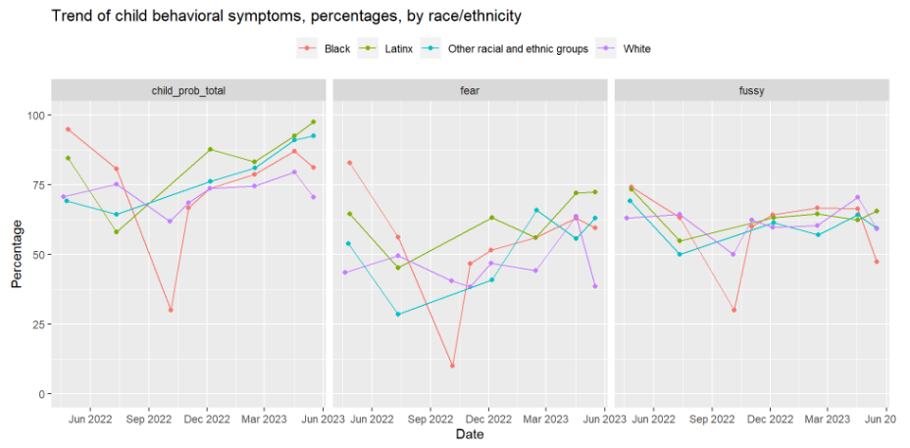
RAPID-fsk: child EMOTIONAL DISTRESS by race/ethnicity

Slide 15
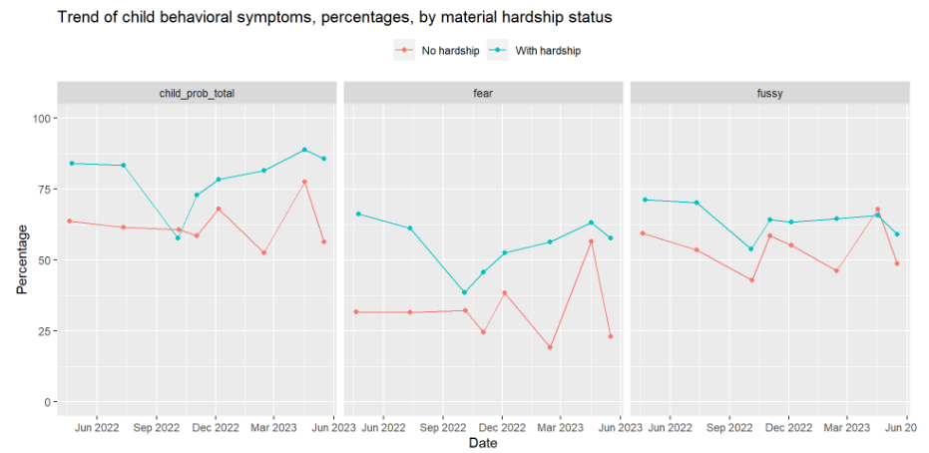
RAPID-fsk: child EMOTIONAL DISTRESS by material hardship

Slide 16
3. Increased Concerns About Children

Slide 17
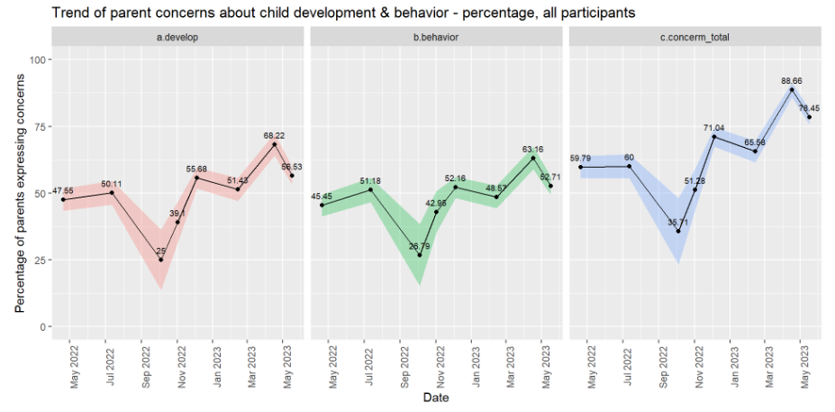
Rapid-fsk: concerns about child development & behavior
Survey Questions:
Currently, do you have any concerns about your child’s learning or development?
Currently, do you have any concerns about your child’s behavior?
Notes:
Both rates of concerns were slightly higher than that in national surveys.
For concerns about child learning & development, the rates in Kent in recent months were around 50-60%, in comparison to national surveys with ranges of 30-50%
For concerns about child development, , the rates in Kent in recent months were around 50-60%, in comparison to national surveys with ranges of 40-50%

Slide 18
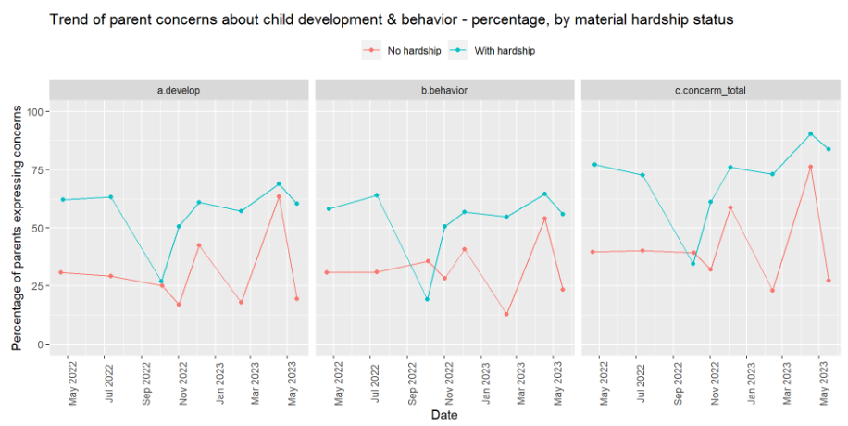
Rapid-fsk: concerns about child development & behavior by material hardship status

Slide 19
4. Quotes from Parents

Slide 20
What are the biggest challenges and concerns for you and your family right now?
Still childcare - I suspect difficulties getting full-time childcare contributed to me being one of the employees selected for layoff when my company faced financial issues. And lack of affordable childcare is preventing me from getting another job. – Parent in Northview
Will be transitioning to center-based care in the fall and on waiting lists. In-home care has become too expensive to be sustainable. – Parent in Grand Rapids
My partner has been forced to take a leave of absence due to COVID-19, which has reduced our family income to meet our daily expenses, and sometimes we can only eat twice a day. – Parent in Wyoming

Slide 21
What is helping you and your family the most right now?
Despite the challenges we're facing, there are some things that have been helping our family stay strong during these difficult times. One of the biggest sources of support has been our extended family and friends who have offered their love, encouragement, and assistance when we need it most. – Parent in Grand Rapids
Right now, our family is relying on a few key resources to help us navigate this challenging period. We've found that keeping open lines of communication and expressing our feelings and concerns openly has helped us stay connected and work together as a team. Additionally, we're grateful for the support of community organizations and online resources that provide helpful tips and advice for families like ours. – Parent in Kentwood
When we received P-EBT it was a godsend. Even if it just gave us a slight break for a month or two during summer, it was wonderful and we were so grateful.– Parent in Grand Rapids

Slide 22
Special focuses

Slide 23
1. Inflation

Slide 24
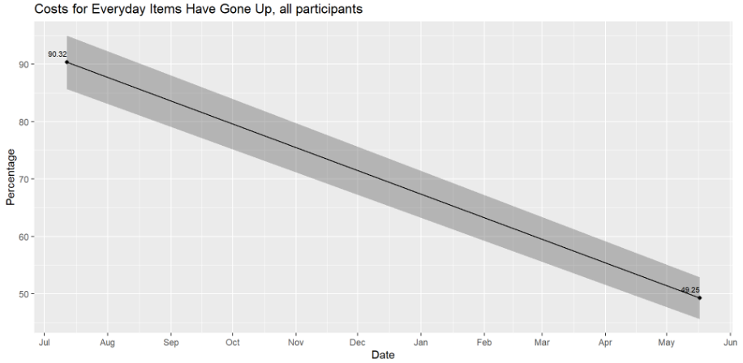
Rapid-fsk: inflation
Survey Question: Have costs for everyday items gone up in your area in the past month?

Slide 25
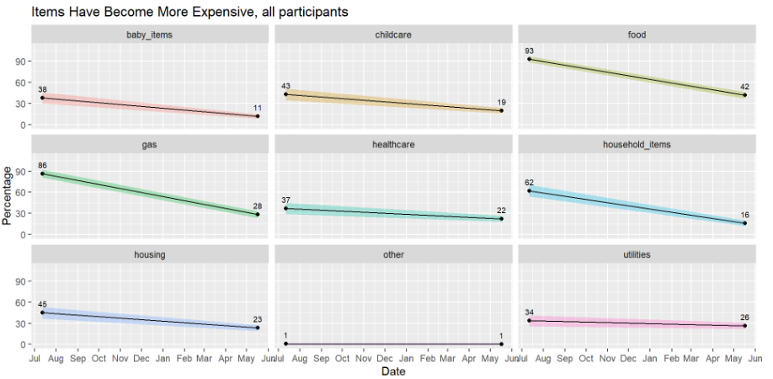
Rapid-fsk: items have become more expensive
Notes:
Food, gas, household items

Slide 26
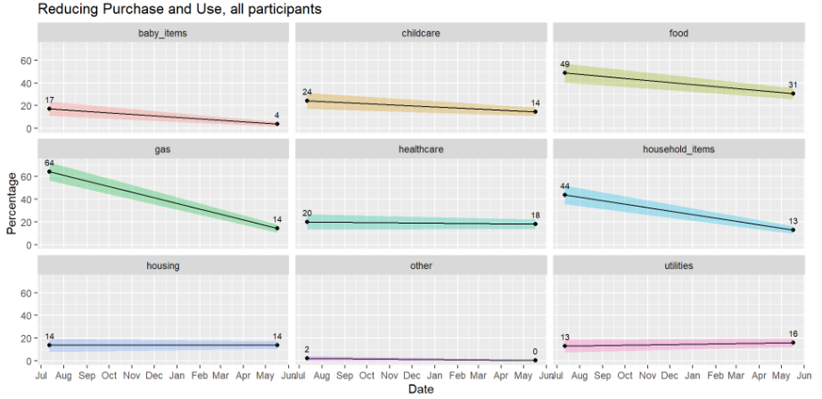
Rapid-fsk: reducing purchase and use
Notes:
Fewer parents reduced purchases of food, gas, and household items because of the increased cost of living. But the rates, especially for food (31%), is still substantial, considering that we know that reducing purchase of food is a indicator of food insecurity.

Slide 27
2. Summer Child Care

Slide 28
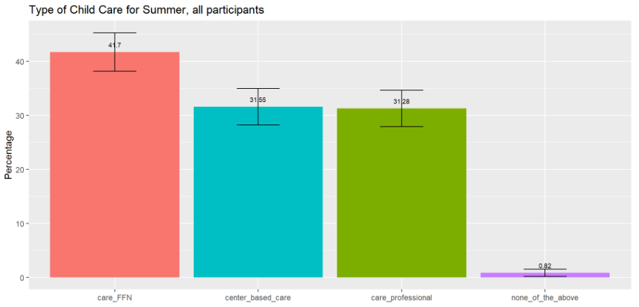
Rapid-fsk: type of summer child care
Survey Question: This summer, what types of child care do you expect to use in a typical week? Select all that apply.
Center-based care (such as a pre-school, day care center, public pre-kindergarten, Head Start, or faith-based nursery school. Please do not include kindergarten.)
Care provided by relatives, friends, or neighbors
Care provided by professional child care providers (not center-based)
None of the above apply
I don’t know

Slide 29
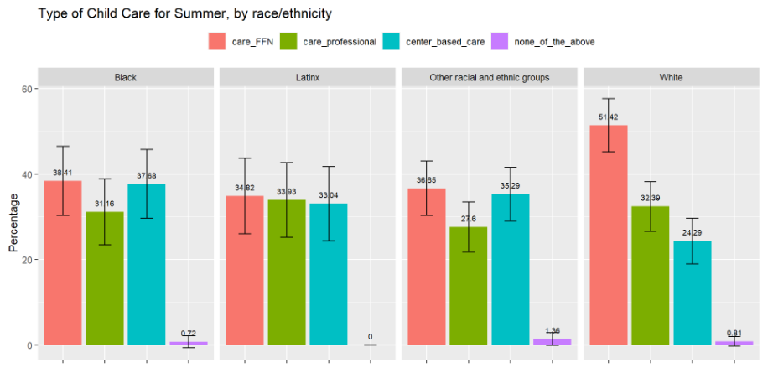
Rapid-fsk: type of summer child care by race/ethnicity

Slide 30
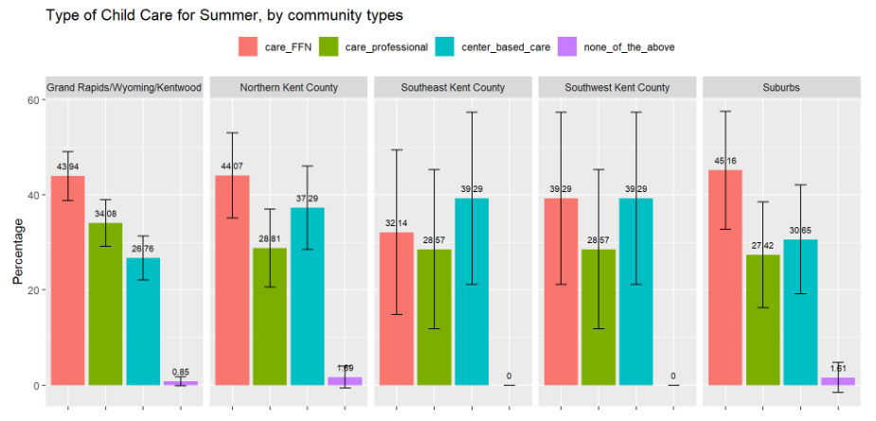
Rapid-fsk: type of summer child care by community types

Slide 31
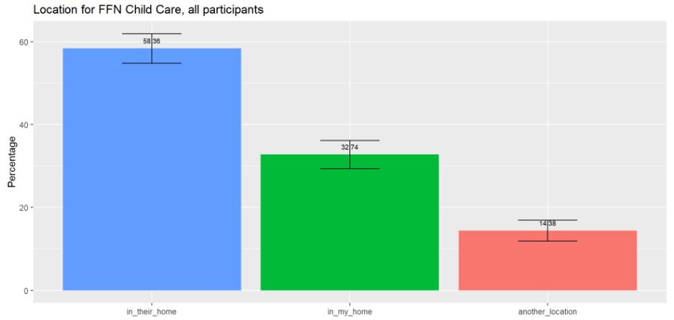
RAPID-FSK: location for ffn child care
Survey Question: Where do you expect your relatives, friends, or neighbors to provide care to your child? Select all that apply.
In my home
In their home
Another location
Note: Analysis only includes respondents who expect to use child care during the summer.

Slide 32
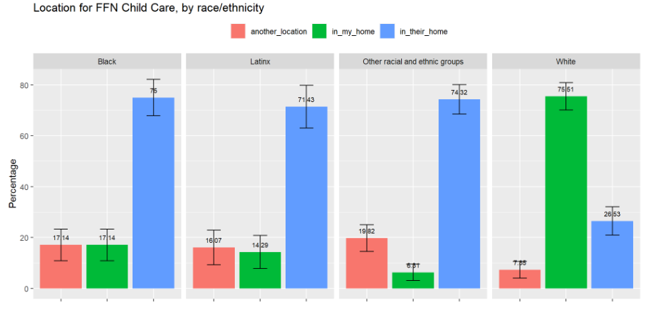
Rapid-fsk: location for ffn child care by race/ethnicity

Slide 33
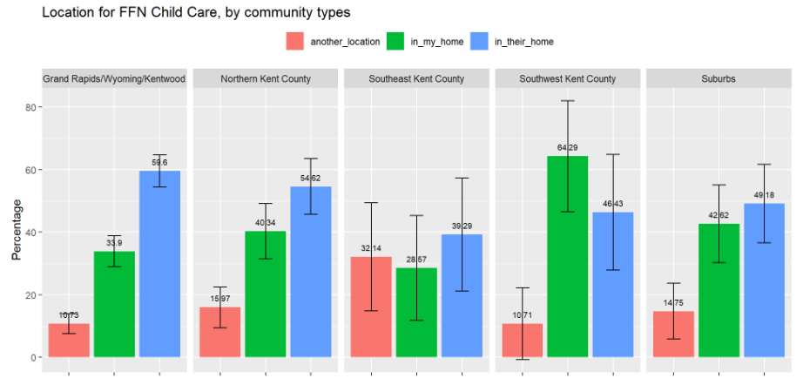
Rapid-fsk: location for ffn child care by community types
Notes:
Southwest Kent county – more prefer to have FFN in home care
Southeast Kent county – more prefer to have FFN care in another location

Slide 34
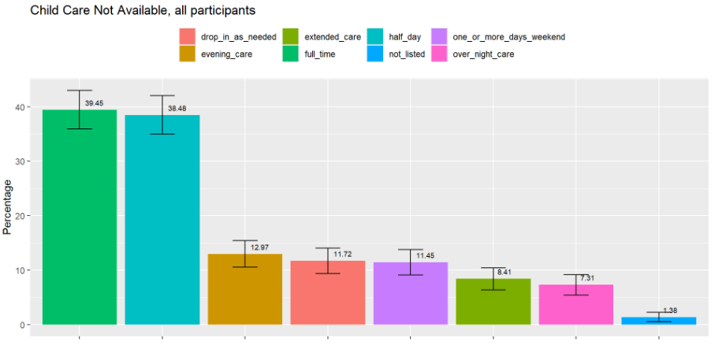
Rapid-fsk: child care not available
Survey Question: When do you need child care that is currently not available? Select all that apply.
Full time
Half Day
After School/Evening Care
Over-night Care
Extended Care (+12 hours)
Drop-in or As-needed care
On one or more days of the weekend
Not listed

Slide 35
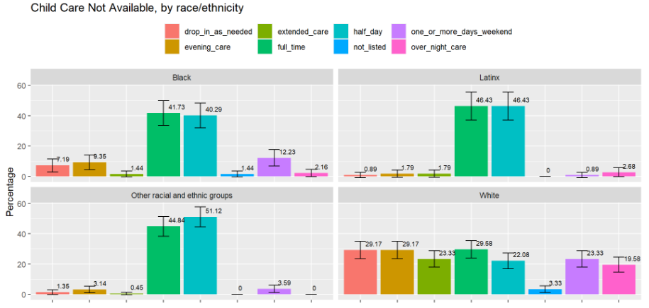
Rapid-fsk: child care not available by race/ethnicity

Slide 36
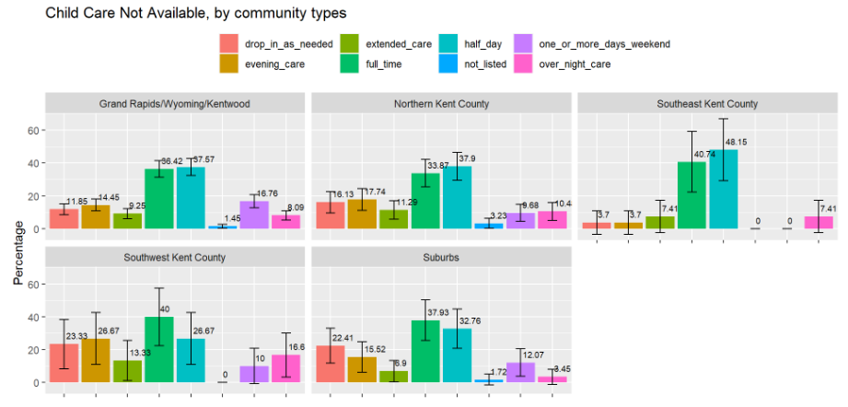
Rapid-fsk: child care not available by community types

Slide 37
3. Receive Information & Participate in Programs (Service Module)

Slide 38
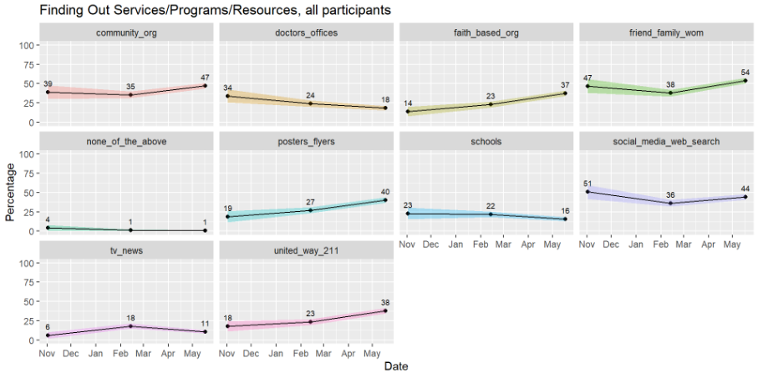
Rapid-fsk: how finding out about services / programs / resources
Survey Question: How do you find out about services, programs, and resources for families and children in Kent County? Select all that apply.
Posters or flyers
United Way 211
Community organizations
Friends/family/word of mouth
Faith-based organizations
Social media/web search
Doctor’s offices
Schools
TV/news
Not listed

Slide 39
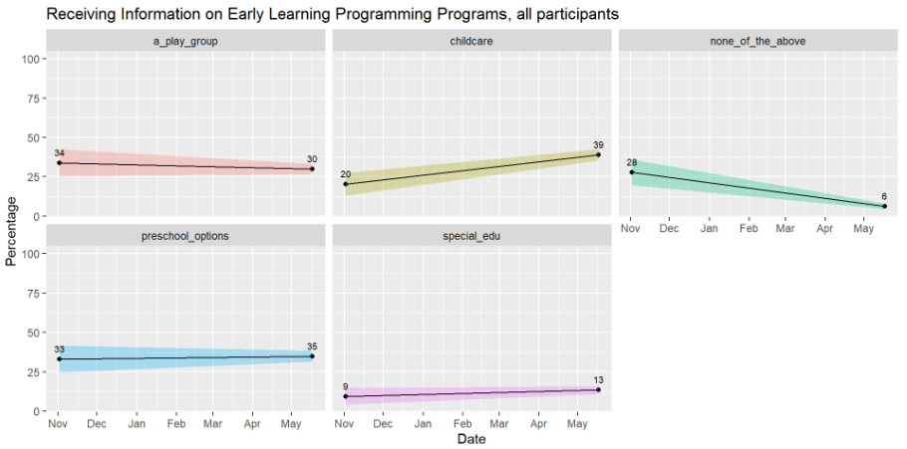
Rapid-fsk: early learning programming programs
Survey Question: Have you or your family received information on any of the following Early Learning Programming programs? Select all that apply.
A play group
Childcare services
Special Education
Preschool options
None of the above

Slide 40
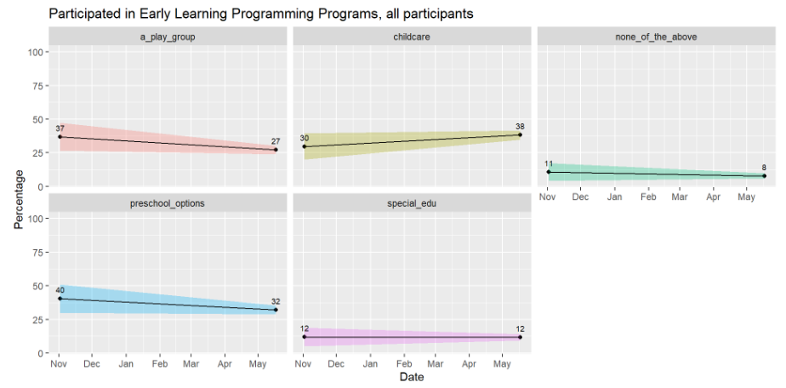
Rapid-fsk: early learning programming programs
Survey Question: Have you or your family participated in any of the following Early Learning Programming programs? Select all that apply.
A play group
Childcare services
Special Education
Preschool options
None of the above

Slide 41
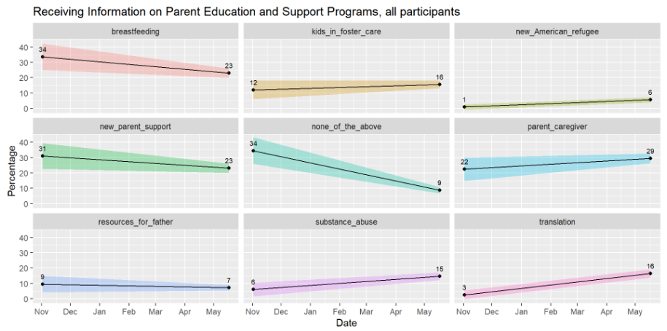
Rapid-fsk: parent education and support programs
Survey Question: Have you received any information about the following Parent Education and Support programs? Select all that apply.
New parent support
Support for kids in foster care
Substance abuse support
Breastfeeding support
Parent or caregiver support
Translation and interpretation support
Resources for fathers
New American or refugee support
None of the above

Slide 42
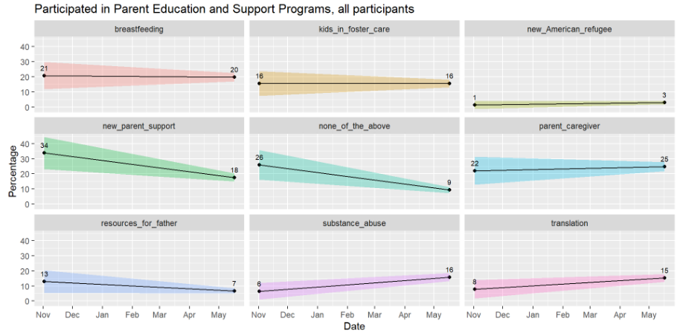
Rapid-fsk: parent education and support programs
Survey Question: Have you participated in any of the following Parent Education and Support programs? Select all that apply.
New parent support
Support for kids in foster care
Substance abuse support
Breastfeeding support
Parent or caregiver support
Translation and interpretation support
Resources for fathers
New American or refugee support
None of the above

Slide 43
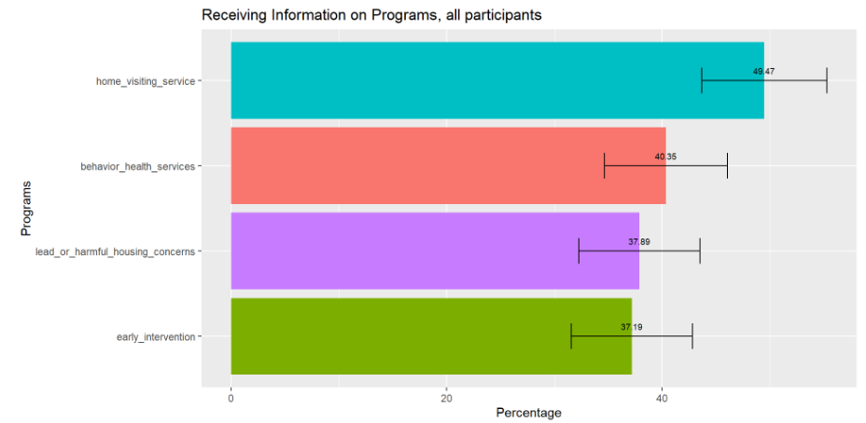
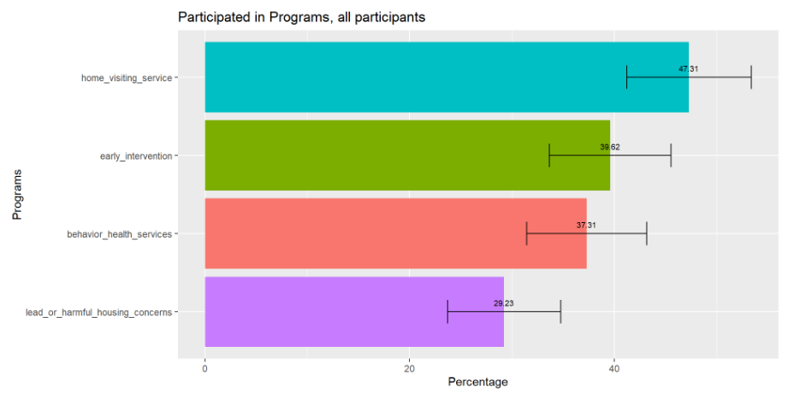
Rapid-fsk: receiving information & participating in programs
Survey Questions:
Have you received information around any of the following programs? Select all that apply.
Have you participated in any of the following programs? Select all that apply.
Behavior Health Services
A Home Visiting Service
Lead or harmful housing concerns
Early Intervention
None of the above
Note: The second question only asked respondents who indicated that they received information of the programs in the first question.

Slide 44
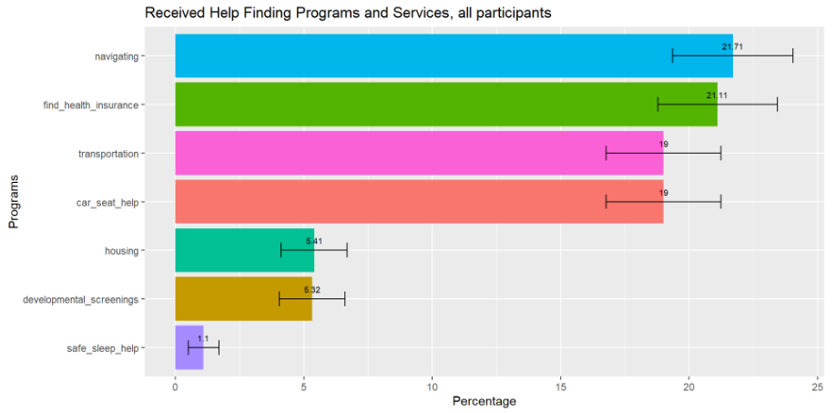
Rapid-fsk: received help finding programs and services/basic needs
Survey Question: Have you received help finding programs and services/basic needs?
Navigating Where to Start
Finding Health Insurance
Car Seat Help
Transportation
Developmental Screenings (ASQs)
Safe Sleep Help
Stable Housing or Housing Support

Slide 45
Thank you questions & feedback

