Slide 1
RAPID-First Steps Kent
Data Briefing – Ongoing Assessment 3
April 18th, 2023

Slide 2
RAPID-FSK Survey Responses
2,327 valid responses from 1,460 parents!
First Steps Kent landing page: n = 614 (26.39%)
Family Futures: n = 89 (3.82%)
Email campaign: n = 34 (1.46%)
Kent Library: n = 22 (0.95%)
Closed Recruitment Survey: n = 8 (0.34%)
Vibrant Futures: n = 9 (0.39%)
ELNC: n = 4 (0.17%)
Other/Unknown source: 1,547 (66.48%)
Responses in Each Survey
Initial Recruitment 1: n = 512, 4/20 -5/06
Initial Recruitment 2: n = 230, 7/12 – 7/26
Ongoing Assessment 1: n = 183, 7/12 – 7/27
Initial Recruitment 3: n = 52, 10/4– 10/20
Ongoing Assessment 2: n = 145, 11/2 – 11/13
Initial Recruitment 4: n = 661, 12/5 – 1/4
Ongoing Assessment 3: n = 539, 2/13 – 2/26

Slide 3
RAPID-FKS current Participant Demographics (n = 1,460)
Race/Ethnicity
2.65% American Indian/Alaska Native (n = 38)
3.14% Asian (n = 45)
13.69% Black (n = 196)
9.08% Hispanic/Latino(a) (n = 130)
2.30% Native Hawaiian/Pacific Islander (n = 33)
68.02%% White (n = 974)
0.21% Other Races (n = 3)
Household Structure
9.72% single-parent households
3.53% households of children with disabilities
Community Types
57.41% City
3.95% Rural East
21.52% Rural North
6.08% Rural South
11.03% Suburbia
Income Levels
55.58% below 200% FPL
41.35% between 200% - 400% FPL
3.08% above 400% FPL
Material Hardship Status
59.12% with hardship
40.88% no hardship

Slide 4
overview
Improvements
Increased Service Awareness & Utilization
Preventive Healthcare Returning to Normal
Decreased Mean Levels of Parent Emotional Distress
Increased Parent Hopefulness
Challenges
Persistent High Level of Material Hardship
Increased Concerns about Children
Increased Level of Child Behavioral Problems
Other Notable Findings
Increased Use & Change in Type of Non-Parental Care
Receiving Information & Participating in Programs

Slide 5
Improvements

Slide 6
1. Increased Service Awareness & Utilization

Slide 7
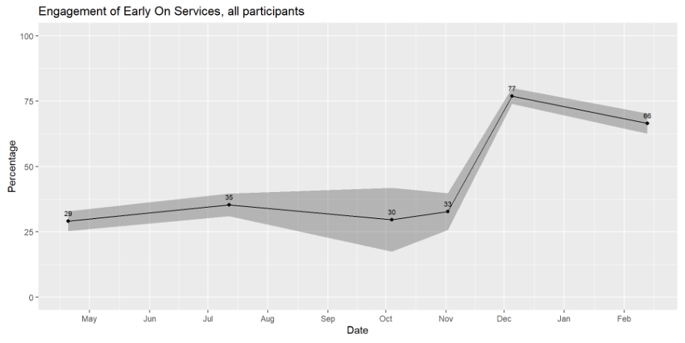
Rapid-fsk: Early on services engagement
Survey Question: Have you received Early On services for this child (your third child under age 6)? - No/Yes/Unsure

Slide 8
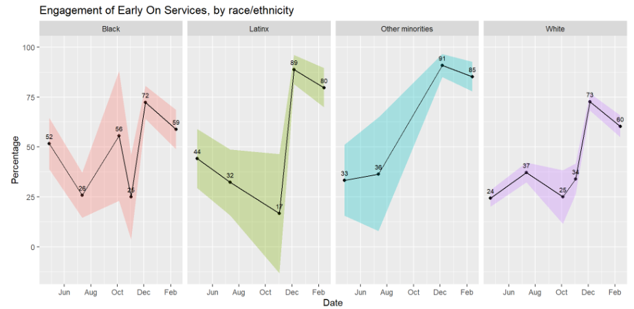
Rapid-fsk: early on services by race/ethnicity

Slide 9
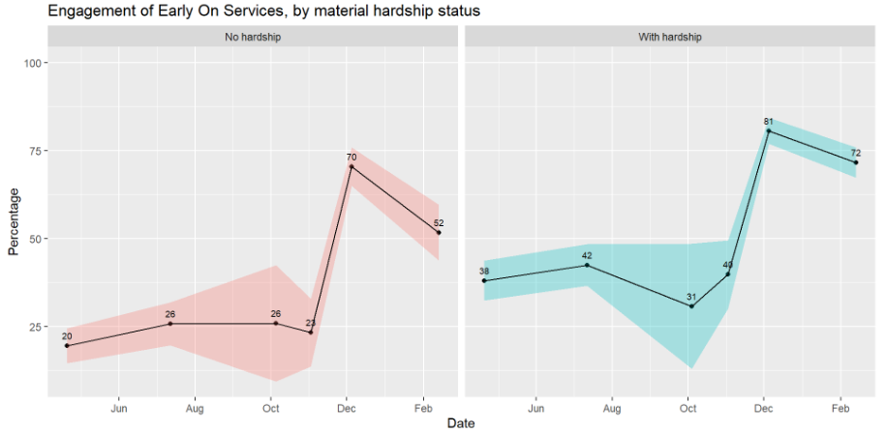
Rapid-fsk: Early on services by material hardship status

Slide 10
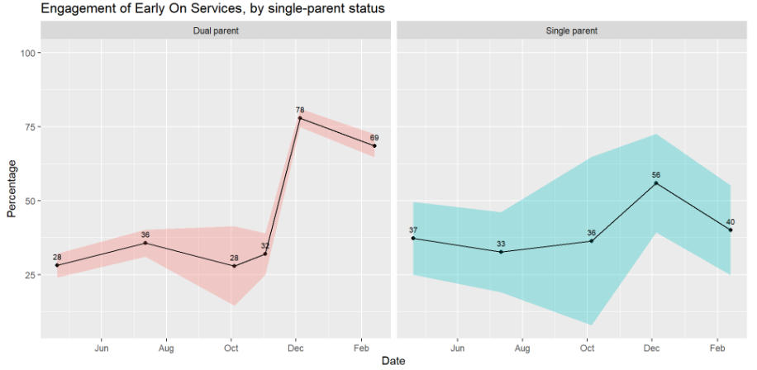
Rapid-fsk: Early on services by single-parent status

Slide 11
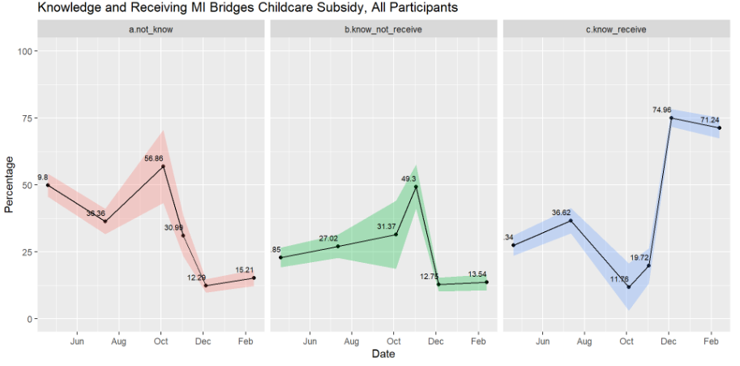
Rapid-fsk: MI Bridge Childcare subsidy
Survey Questions:
Do you know about the MI Bridges childcare subsidy? - Yes/No Are you currently receiving the MI Bridges childcare subsidy for any of your children? - Yes/No

Slide 12
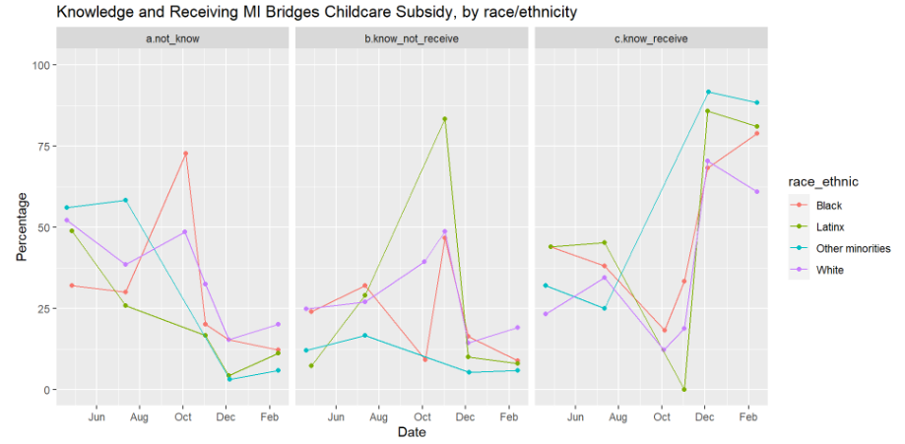
RAPID-FSK: MI Bridge by race/ethnicity

Slide 13
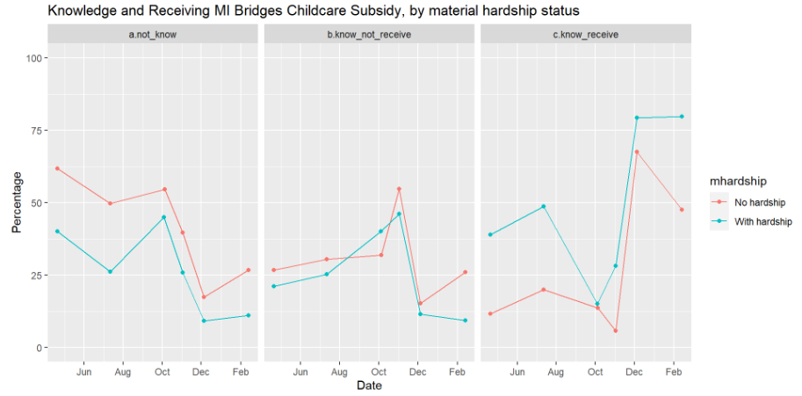
Rapid-fsk: MI Bridge by material hardship status

Slide 14
2. Preventive Healthcare Returning To Normal

Slide 15
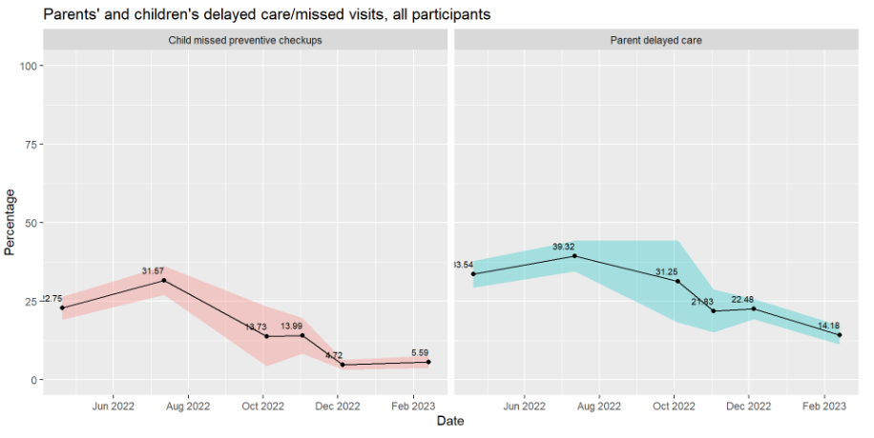
Rapid-fsk: Delayed/missed care

Slide 16
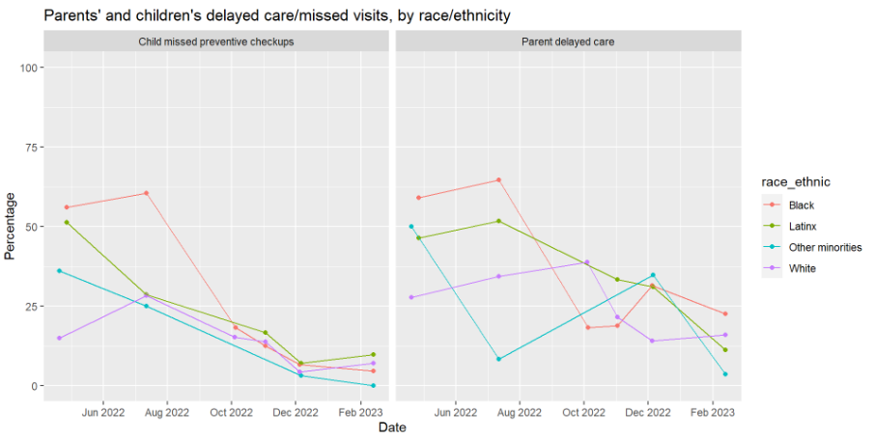
Rapid-fsk: Delayed/missed care by race/ethnicity

Slide 17
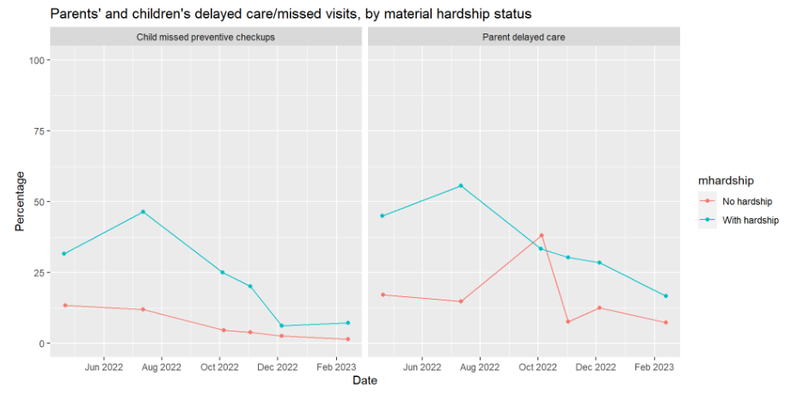
Rapid-fsk: Delayed/missed care by hardship status

Slide 18
3. Decreased Mean Levels of Parent Emotional Distress

Slide 19
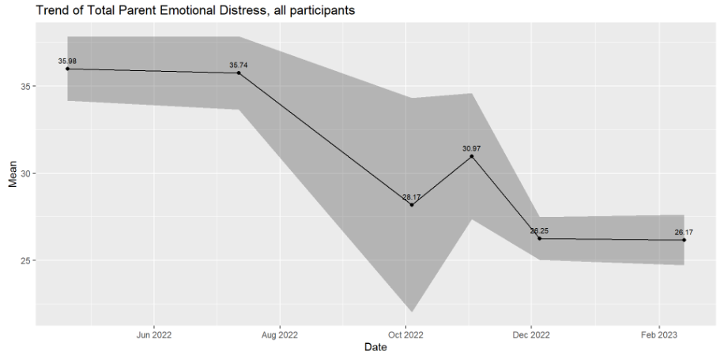
Rapid-fsk: parent emotional distress score
Note: For composite scores, scores of depression, anxiety, loneliness, and stress symptoms were transformed to a range of 0-100 and averaged to calculate the composite emotional distress scores.

Slide 20
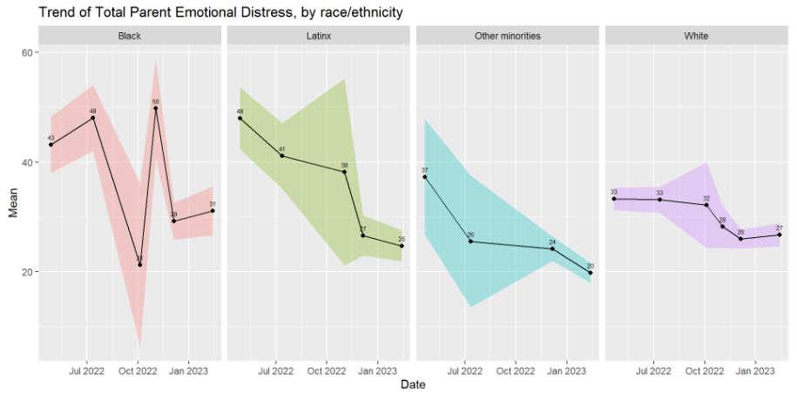
Rapid-fsk: parent emotional distress by race/ethnicity

Slide 21
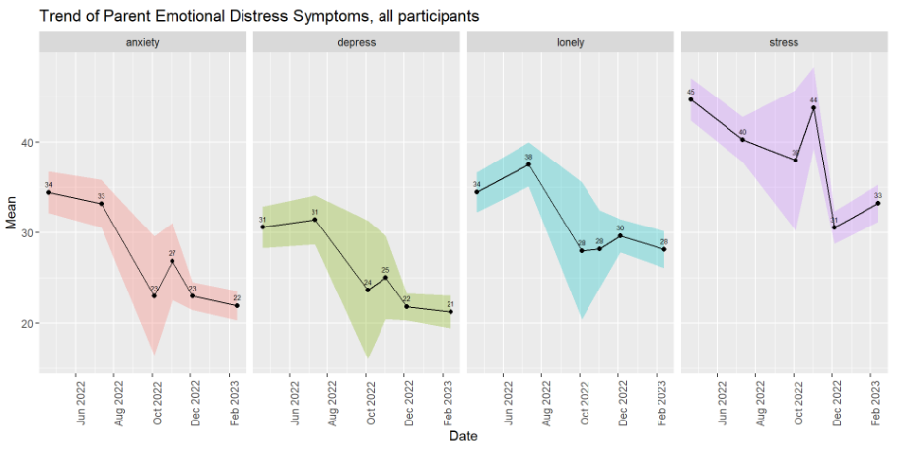
Rapid-fsk: parent emotional distress symptoms

Slide 22
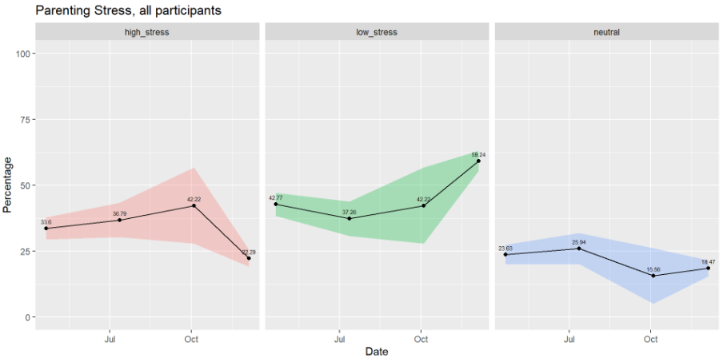
Rapid-fsk: parental stress
Survey questions: Since the COVID-19 pandemic, I often felt like I could not handle things very well
Since the COVID-19 pandemic, being a parent is manageable, and any problems are easily solved (reversely coded)
Note: data only collected in initial recruitment surveys

Slide 23
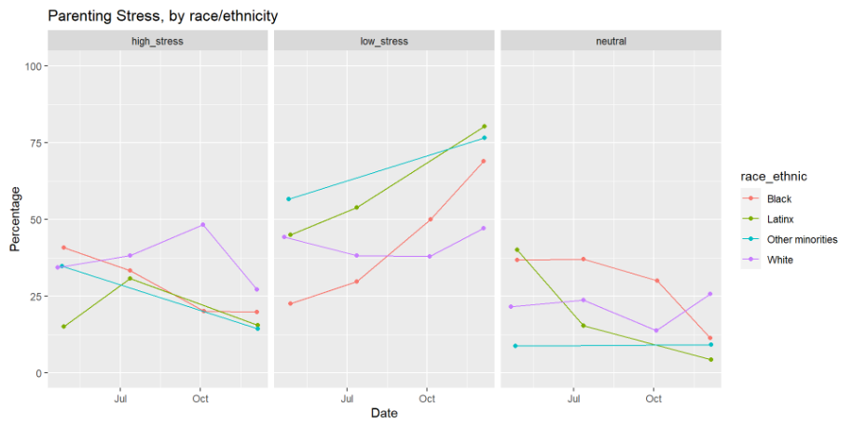
Rapid-fsk: parental stress by race/ethnicity

Slide 24
4. Increased Parent Hopefulness

Slide 25
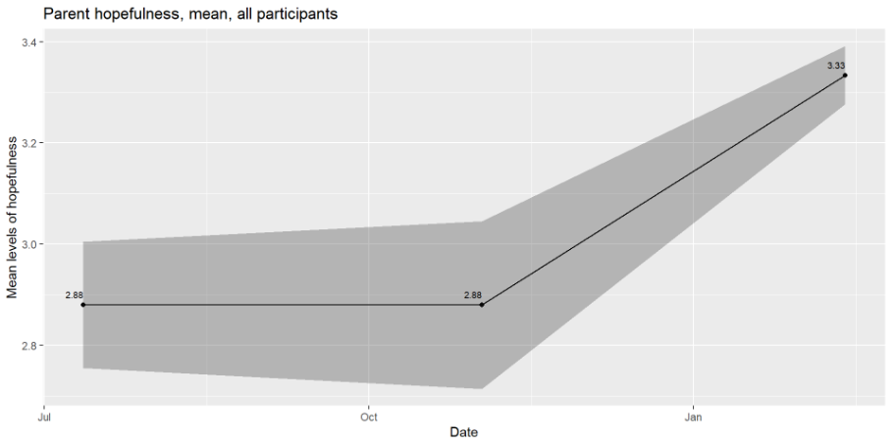
Rapid-fsk: parent hopefulness
Note: data only collected in ongoing assessment surveys

Slide 26
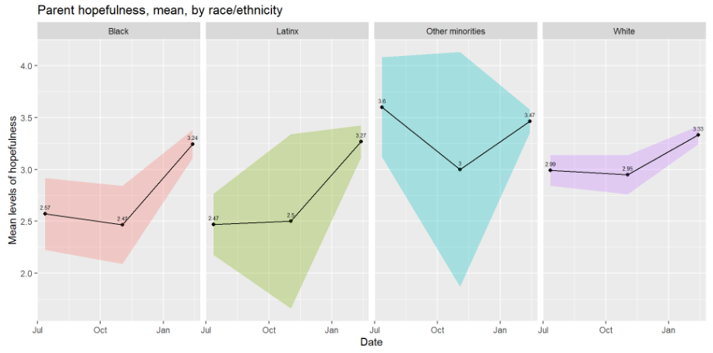
Rapid-fsk: parent hopefulness by race/ethnicity

Slide 27
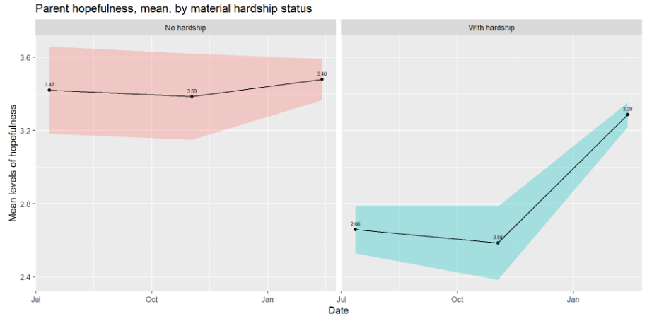
Rapid-fsk: parent hopefulness by material hardship status

Slide 28
What is helping you and your family the most right now?
Early on and PT, support from friends and family. – Parent in Belmont
Being able to work from home a few days per week and being fortunate enough that my salary is enough for my wife to be a stay-at-home parent without losing too much of our savings until our girls are in school. – Parent in Rockford
Solid counseling relationships for parents providing parenting tools. – Parent in Sparta
Increase subsidies and reduce daycare center fees. – Parent in Wyoming

Slide 29
Challenges

Slide 30
1. Persistent High Level of Material Hardship

Slide 31
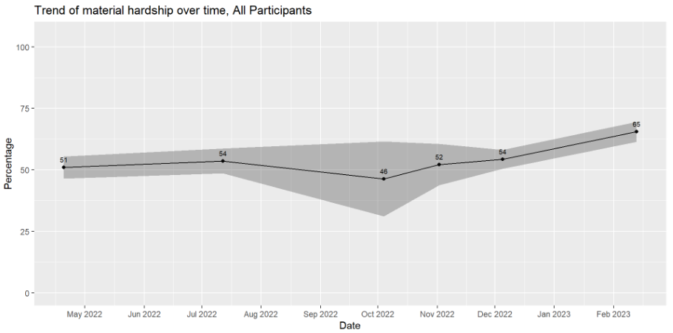
RAPID-FKS Survey: Material Hardship rate
Note: Material hardship is defined as having difficulty paying for at least 1 types of basic needs among: food, housing, utilities, childcare, healthcare, and social/emotional needs.

Slide 32
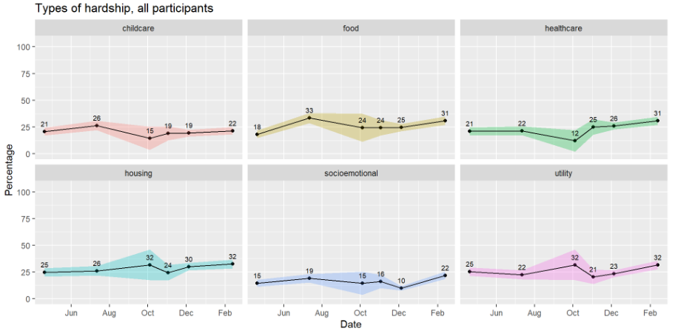
RAPID-FKS Survey: Material Hardship types
Notes:
In recent months: housing, food & utility, healthcare, childcare, and socioemotional needs

Slide 33
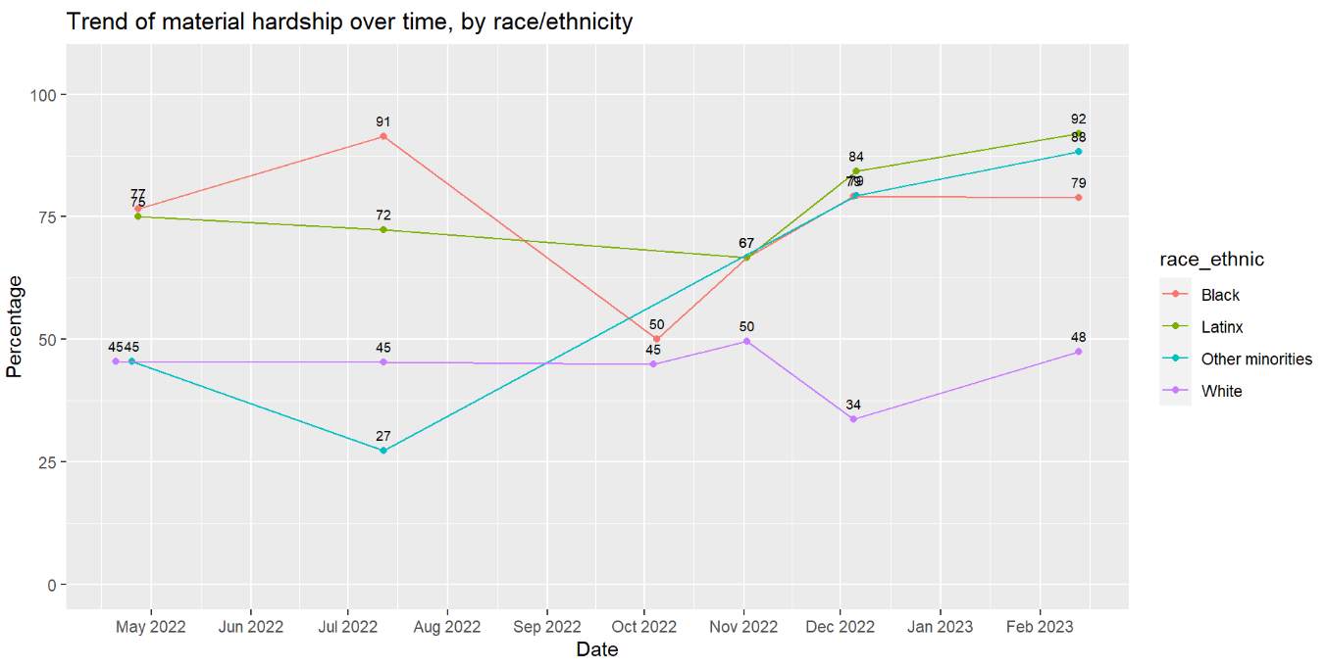
RAPID-FKS Survey: Material Hardship rate by race/ethnicity
Notes:
12 Other minorities – small sample

Slide 34
2. Increased Concerns About Children

Slide 35
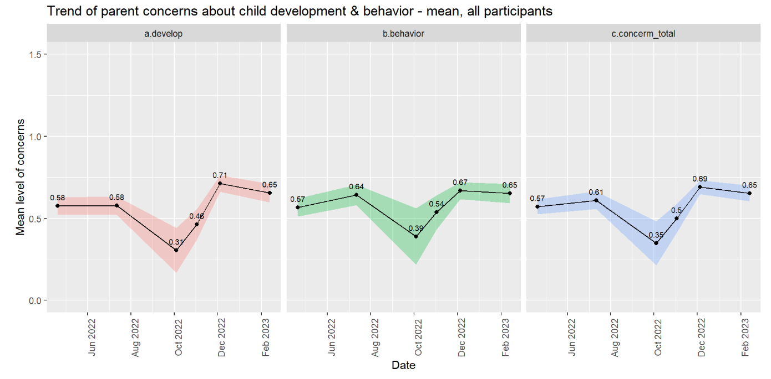
Rapid-fsk: concerns about child development & behavior
Note: individual scores (i.e., “develop” & “behavior) and average scores of the two items (i.e., "concern total”) were used in analyses

Slide 36
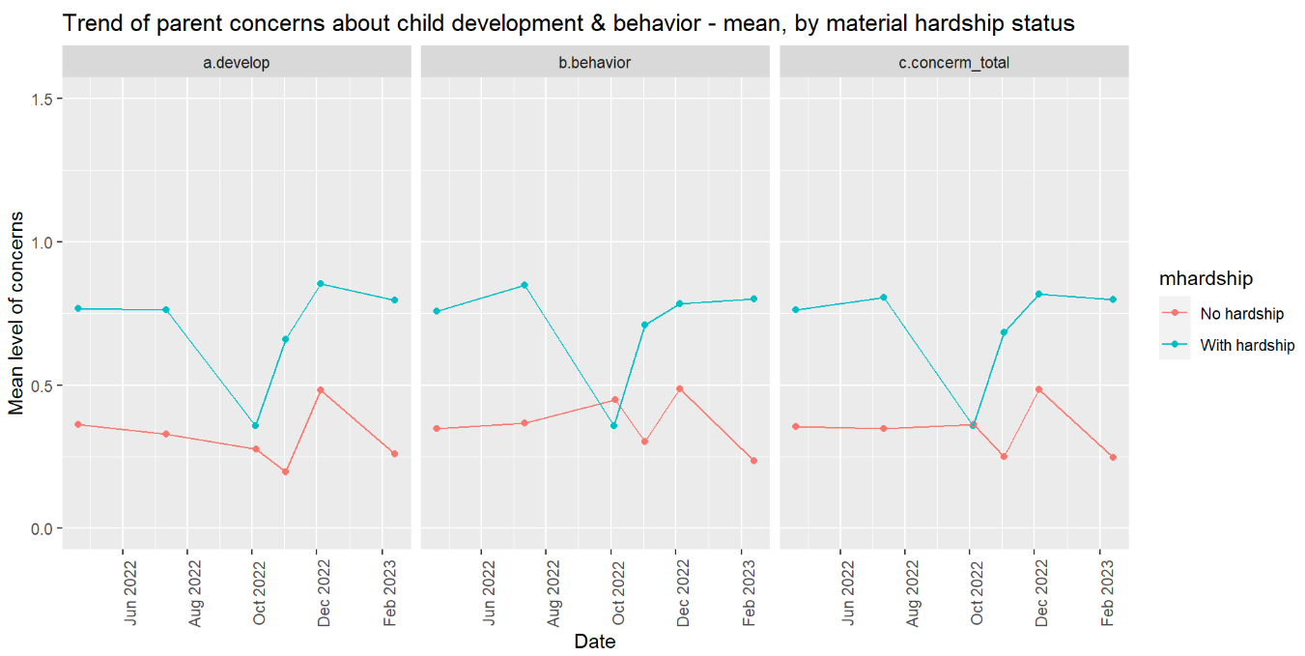
Rapid-fsk: concerns about child development & behavior by material hardship status

Slide 37
3. Increased Level of Child Behavioral Problems

Slide 38
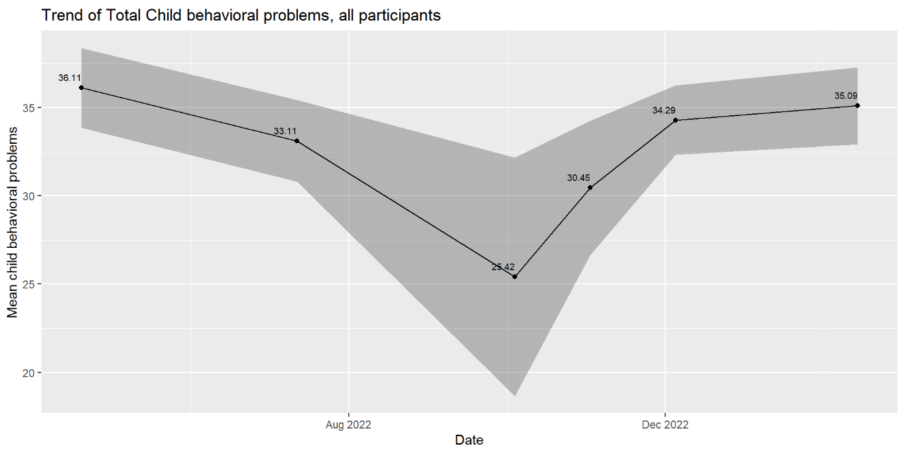
RAPID-fsk: child behavior problems
Note: Child behavioral problems was a composite score of their fussiness/defiance & fear/anxiety, with a range of 0-2.

Slide 39
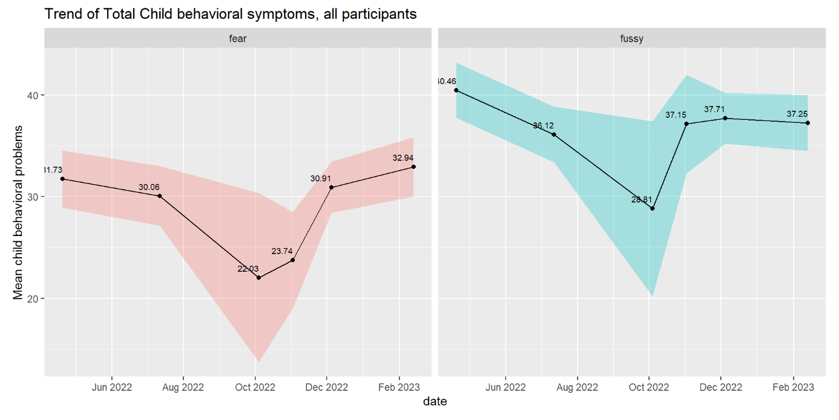
RAPID-fsk: child behavior symptoms

Slide 40
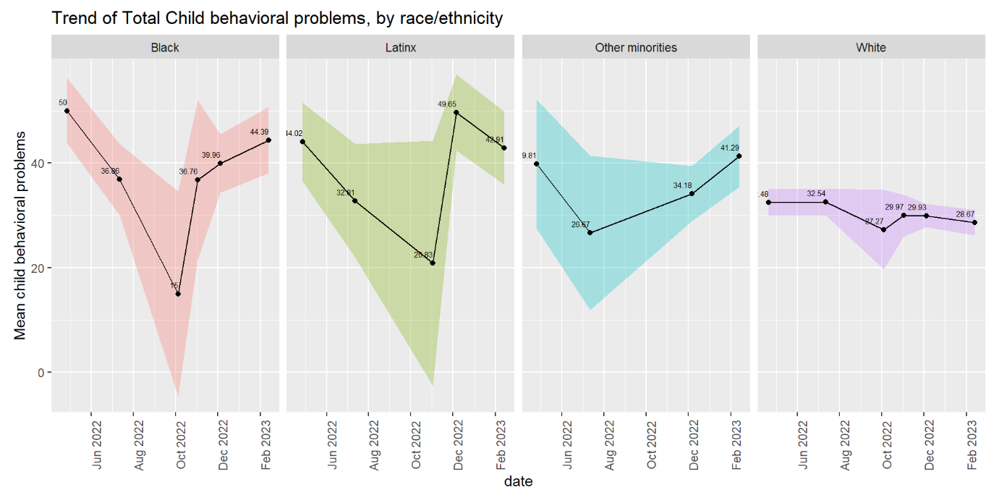
RAPID-fsk: child behavior problems by race/ethnicity

Slide 41
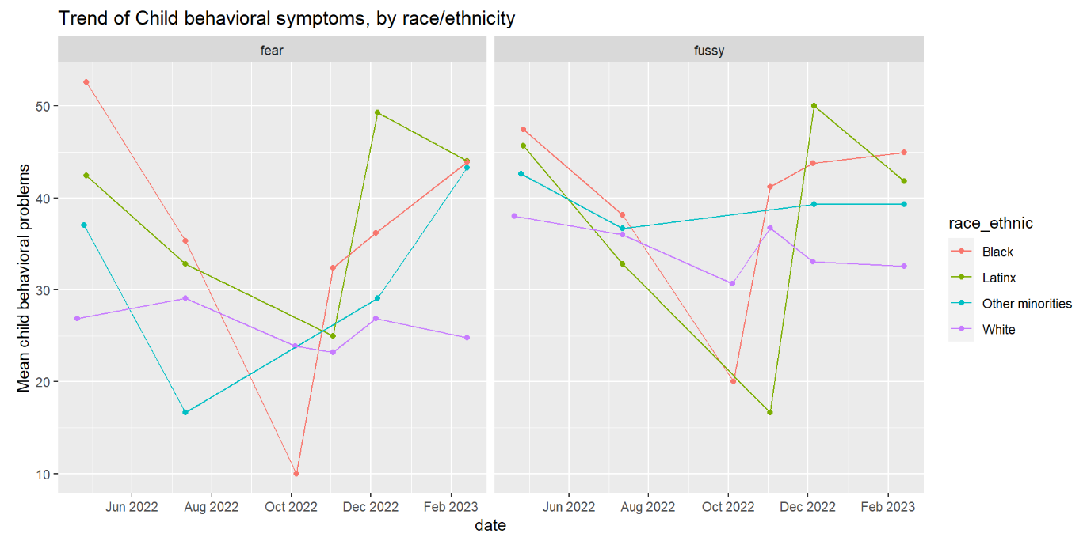
RAPID-fsk: child behavior symptoms by race/ethnicity

Slide 42
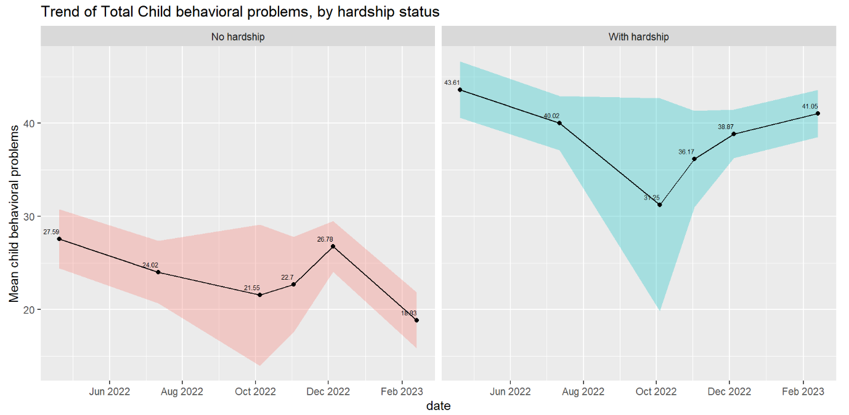
RAPID-fsk: child behavior problems by material hardship status

Slide 43
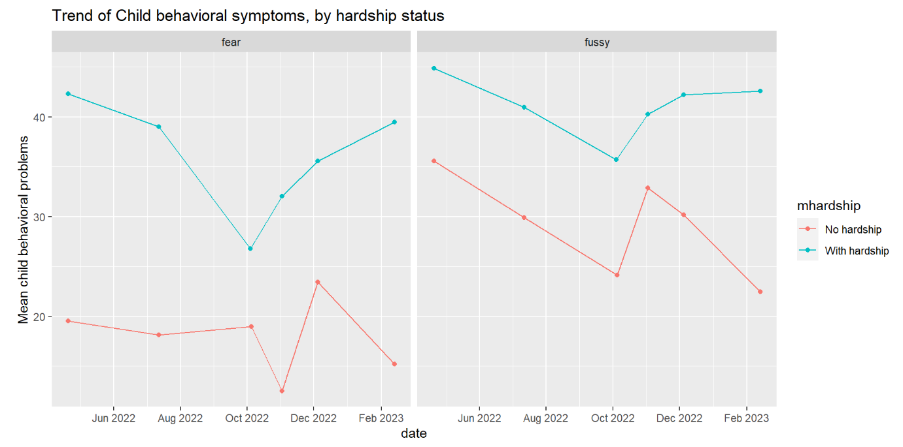
RAPID-fsk: child behavior symptoms by material hardship status

Slide 44
What are the biggest challenges and concerns for you and your family right now?
Don't have enough money to buy household items to support me and my family. I've been having some anxiety lately and I'd like to get support from mental health resources to relieve my stress. – Parent in Wyoming
I don't have enough income to meet my childcare needs and my children are having dietary problems. – Parent in Kentwood
Keeping my kids on track academically due to COVID learning loss. – Parent in Grand Rapids

Slide 45
Other Notable Findings

Slide 46
1. Increased Use & Change in Type of Non-parental Care

Slide 47
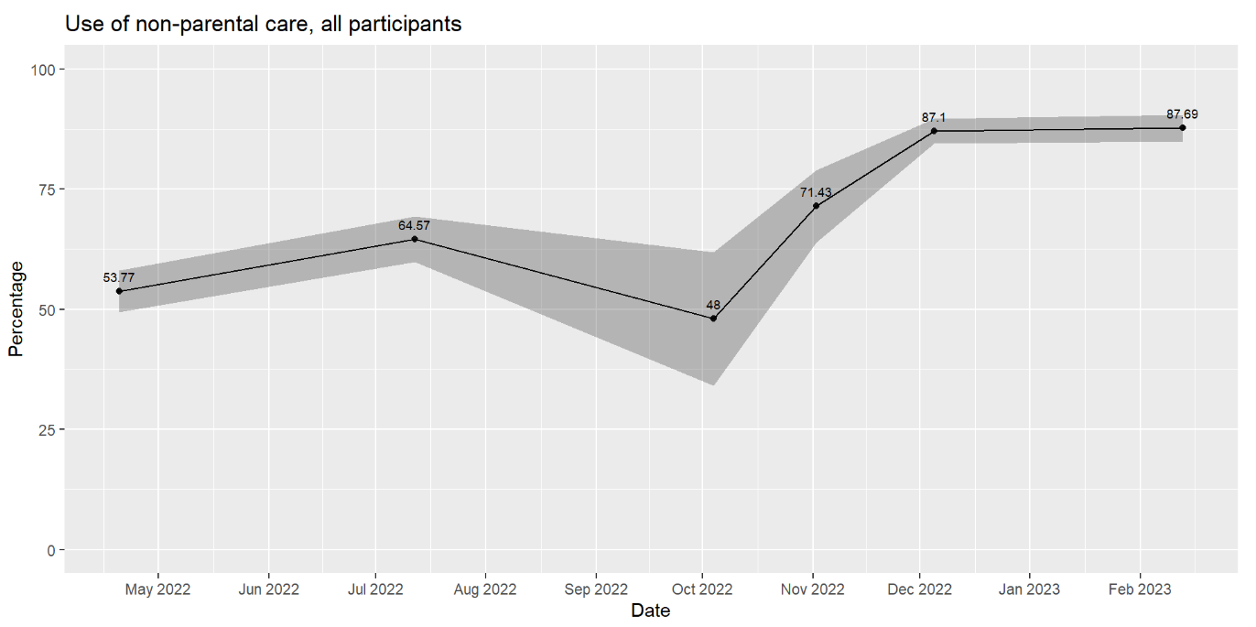
Rapid-fsk: use of non-parental care

Slide 48
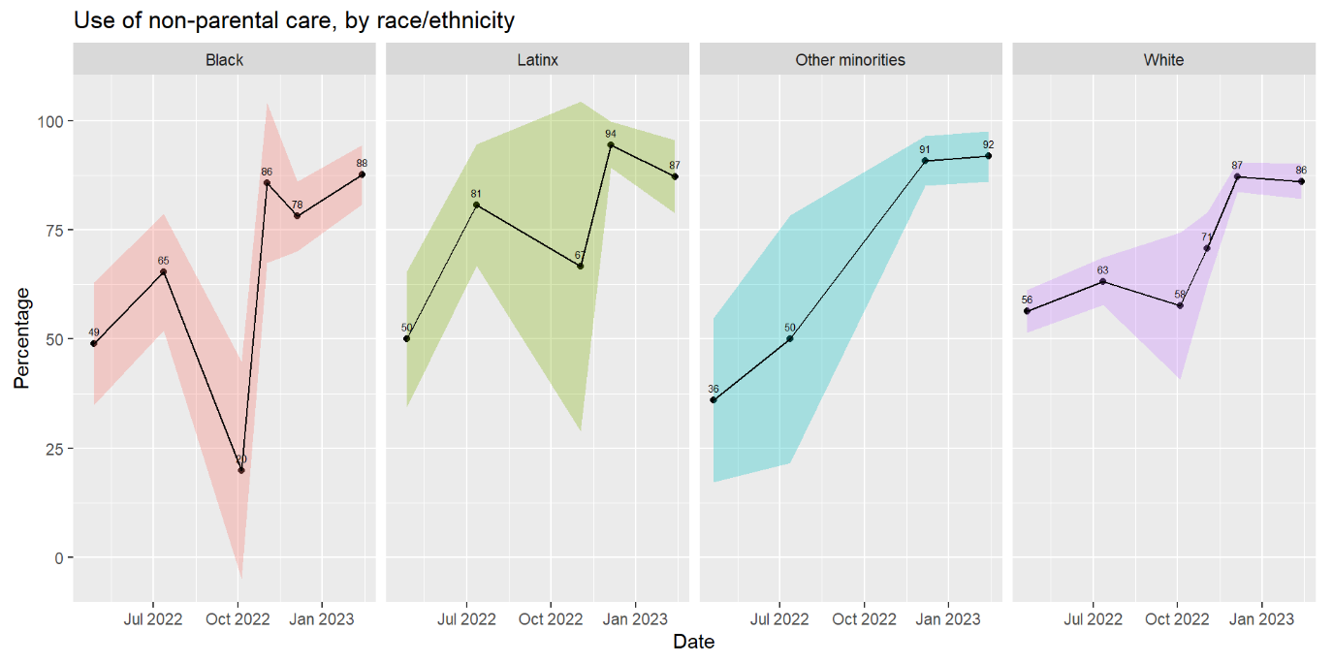
Rapid-fsk: Use of non-parental care by race/ethnicity

Slide 49
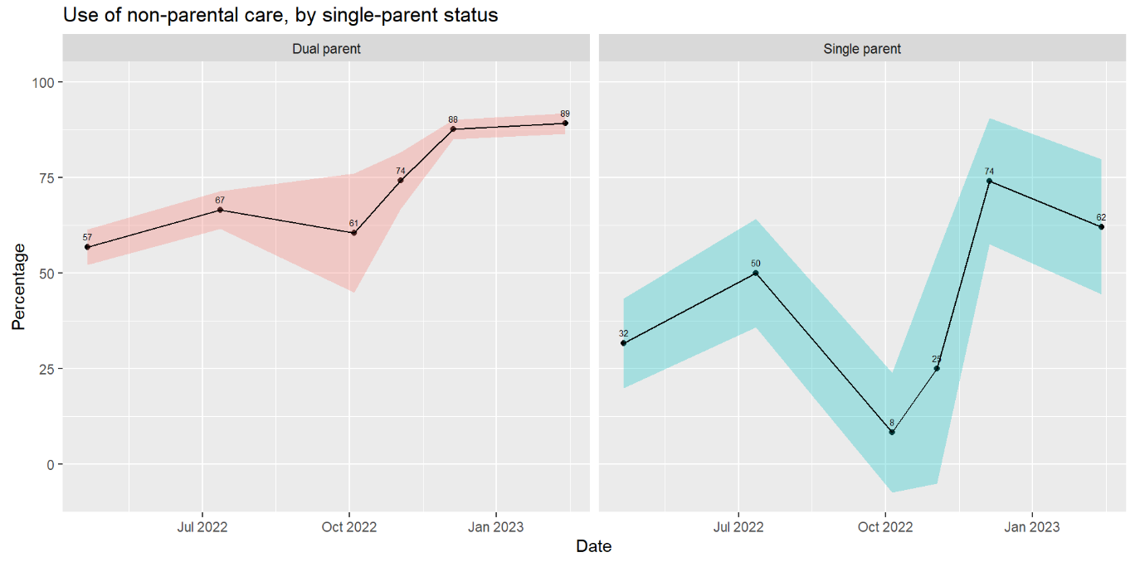
Rapid-fsk: Use of non-parent care by single-parent status

Slide 50
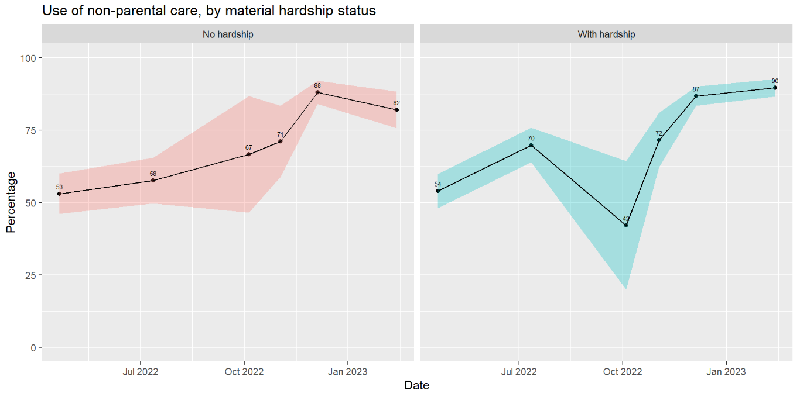
Rapid-fsk: use of non-parent care by material hardship status

Slide 51
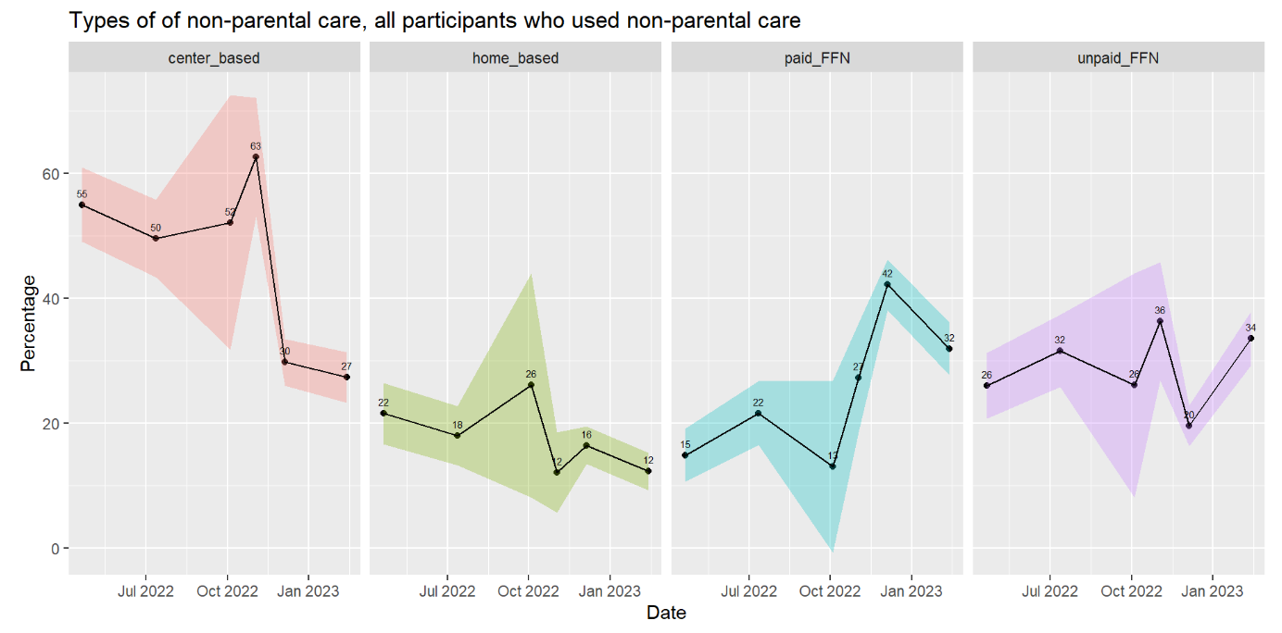
Rapid-fsk: type of non-parent care

Slide 52
2. Awareness & Participation in Programs

Slide 53
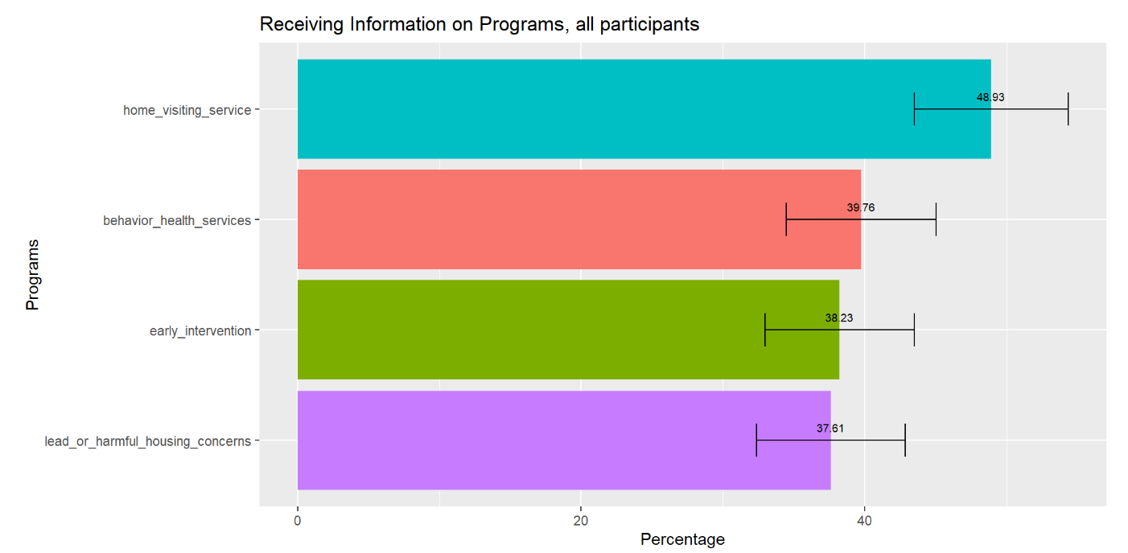
Rapid-fsk: Receiving information on programs

Slide 54
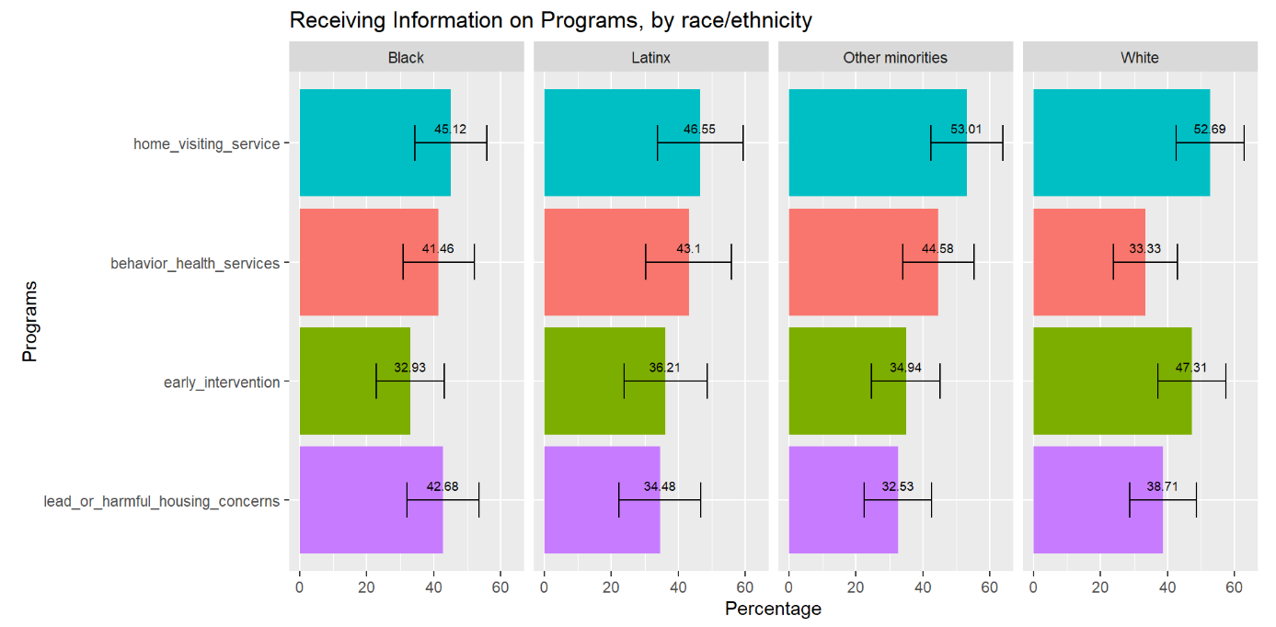
Rapid-fsk: Receiving program information by race/ethnicity

Slide 55
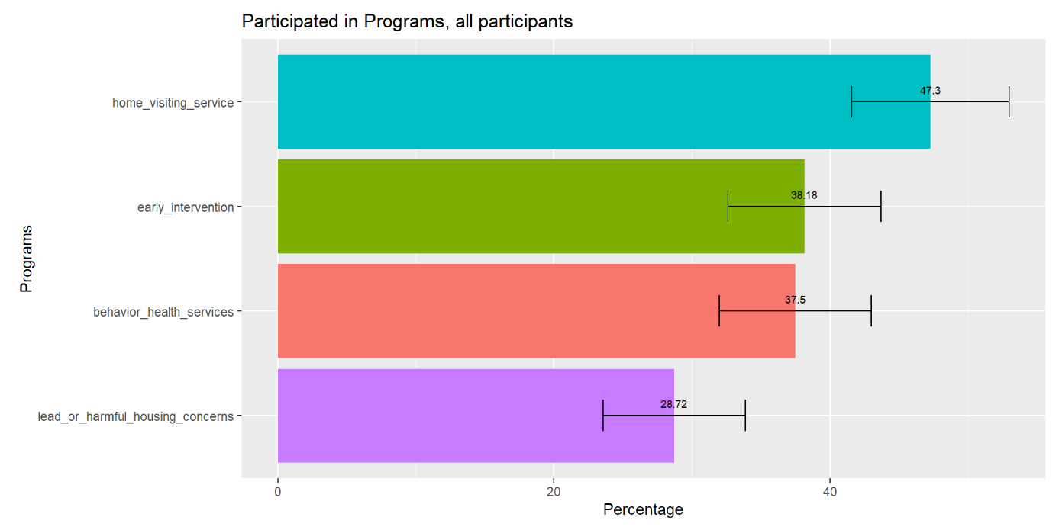
Rapid-fsk: participating in programs

Slide 56
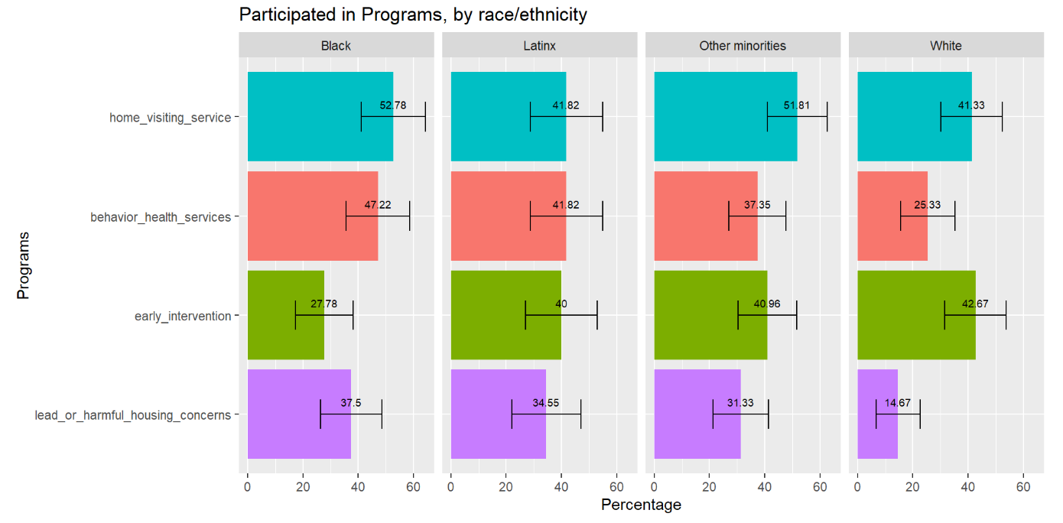
Rapid-fsk: participating in programs by race/ethnicity

Slide 57
Thank you questions & feedback

