Slide 1
RAPID-First Steps Kent
Data Briefing – Ongoing Assessment 6
March 13th, 2024

Slide 2
RAPID-FSK: number of Survey Responses
4,652 valid responses from 1,750 parents!
Initial Recruitment (IR) Surveys
Ongoing Assessment (OA) Surveys
IR Survey # | Dates | # of Participants
1 | April & May 2022 | 476
2 | July 2022 | 156
3 | October 2022 | 49
4 | December & January 2023 | 563
5 | April 2023 | 449
OA Survey # | Dates | # of Participants
1 | July 2022 | 213
2 | November 2022 | 106
3 | February 2023 | 455
4 | May 2023 | 734
5 | July 2023 | 734
6 | November 2023 | 717

Slide 3
RAPID-FSK: current Participant Demographics (n = 1,750)
Race/Ethnicity
5% American Indian/Alaska Native
5% Asian
15% Black
12% Hispanic/Latinx
5% Native Hawaiian/Pacific Islander
57% White
<1% Multi-Race
<1% Other Races
Household Structure
8% single-parent households
8% households of children with disabilities
Community Types
55% Grand Rapids/Wyoming/Kentwood
5% Southeast Kent County Communities
23% Northern Kent County Communities
5% Southwest Kent County Communities
12% Suburb Communities
Income Levels
29% below 200% FPL
63% between 200% - 400% FPL
8% above 400% FPL
Material Hardship Status
72% with hardship
28% no hardship

Slide 4
overview
Improvements
Increased Employment Rate
Increased Awareness Gained through RAPID-FSK Surveys
Parent Quotes
Challenges
Increased Concerns about Children’s Emotional Distress, Development, and Behavior
Persistent High Level of Material Hardship
Parent Quotes
Other Findings

Slide 5
Improvements

Slide 6
1. Increased Employment Rate

Slide 7
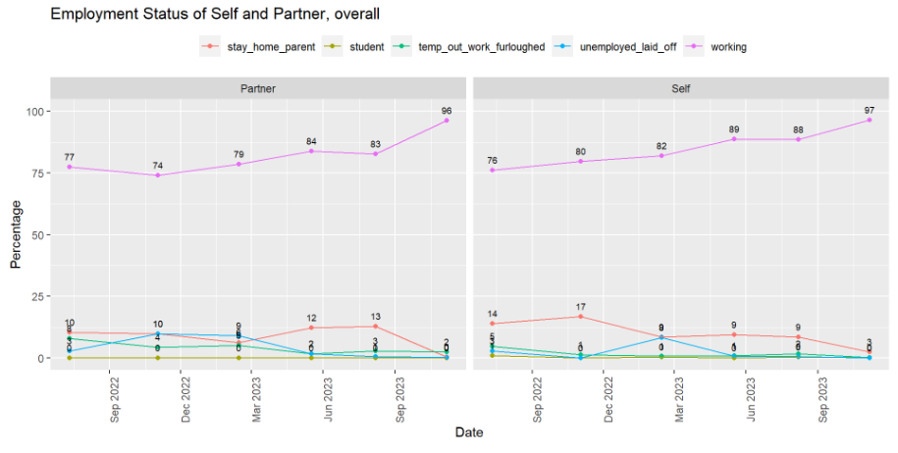
RAPID-FSK: employment status

Slide 8
2. Awareness of Child Care and Services Increased from Responding

Slide 9
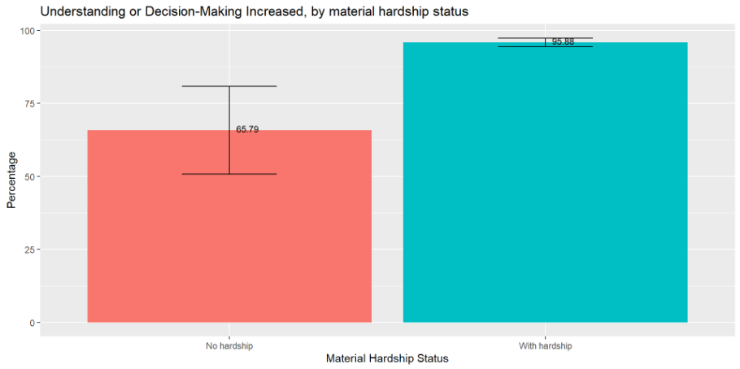
Rapid-fsk: understanding or decision-making increased, by material hardship status
Notes:
Overall, 94.3% of respondents said their understanding or decision-making about child care increased from responding to previous RAPID-Kent County surveys.

Slide 10
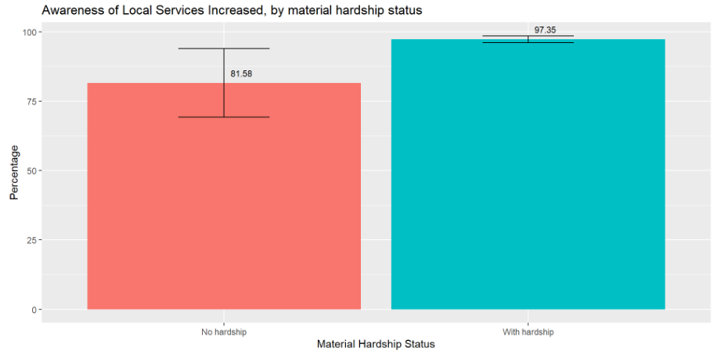
Rapid-fsk: awareness of local services increased, by material hardship status
Notes:
Overall, 96.5% of respondents said their awareness of local services increased from responding to previous RAPID-Kent County surveys.

Slide 11
RAPID-FSK: what has helped families
What has helped you and your family the most right now?
“Community groups stepped up when schools shut down, providing educational support and activities for parents. I don't know what we would have done without them.” Parent in Northview
“When we received P-EBT it was a godsend. Even if it just gave us a slight break for a month or two during summer, it was wonderful, and we were so grateful.” Parent in Grand Rapids
“Longer preschool days have been helpful for our child's father to have some decompress time during the days. The ASQs are also helpful for knowing our child has been on track and of any concerns over these first years of his life.” Parent in Grandville
P-EBT = Pandemic Electronic Benefit Transfer, a supplemental food assistance benefit for families who lost access to free or reduced-price school meals due to the pandemic

Slide 12
Challenges

Slide 13
1. Increased Concerns about Children Emotional Distress, Development & Behavior

Slide 14
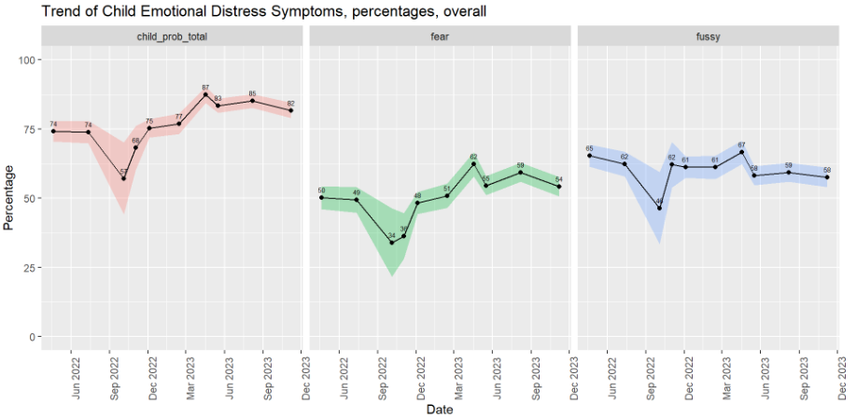
RAPID-fsk Survey: child emotional distress
Notes:
12 Other minorities – small sample

Slide 15
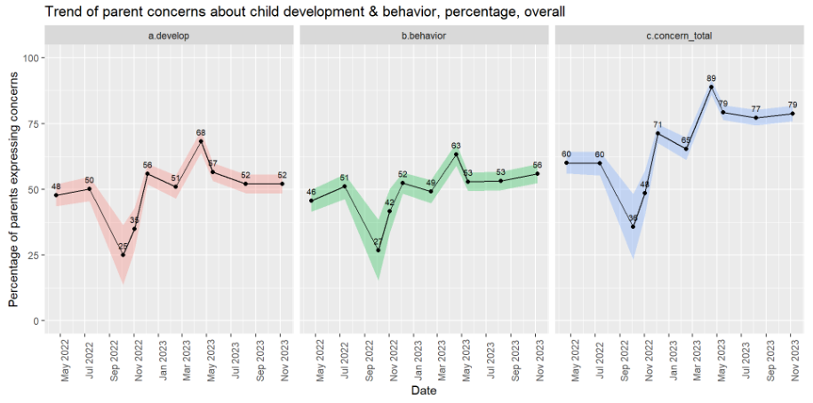
Rapid-fsk: concerns about child development & behavior
Note: individual scores (i.e., “develop” & “behavior) and average scores of the two items (i.e., "concern total”) were used in analyses

Slide 16
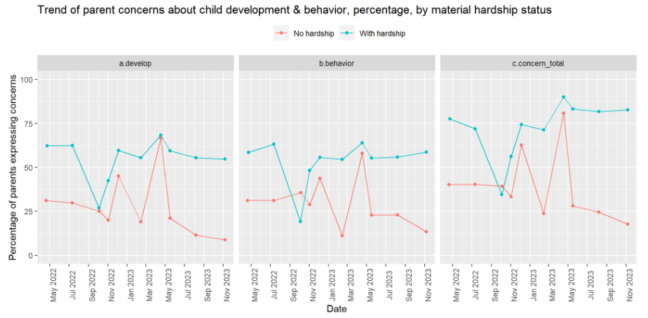
Rapid-fsk: concerns about child development & behavior by material hardship status

Slide 17
2. Persistent High Level of Material Hardship

Slide 18
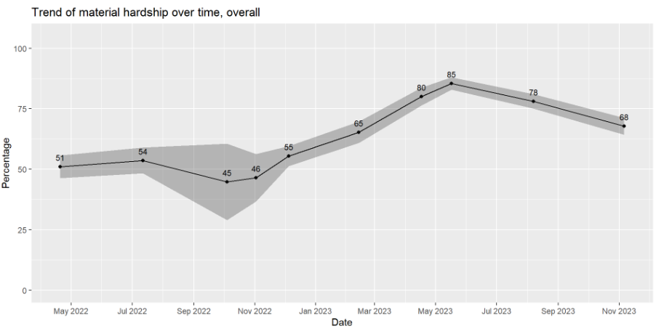
RAPID-FSk Survey: Material Hardship rate
Note: Material hardship is defined as having difficulty paying for at least 1 type of basic needs among: food, housing, utilities, childcare, healthcare, and social/emotional needs.

Slide 19
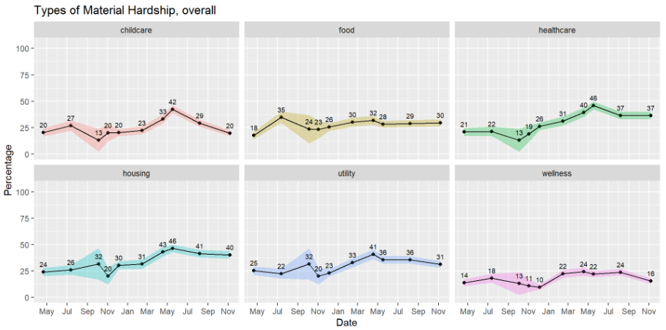
RAPID-Fsk Survey: Material Hardship types

Slide 20
RAPID-FSK: challenges and messages to policy-makers
What are the biggest challenges and concerns for you and your family right now?
“The cost of everything! We have significant expenses for transportation, child care, and food.” Parent in Grandville
“Making enough money to make student loan payments.” Parent in Cedar Springs
What would you like your elected officials or other policymakers to know about how your family is doing or what you need during this time?
“We need high quality, affordable child care. There are no available centers.” Parent in Northview
“Please be bold in your ask of the child care millage!!!” Parent in Kent County

Slide 21
OTHER FINDINGS

Slide 22
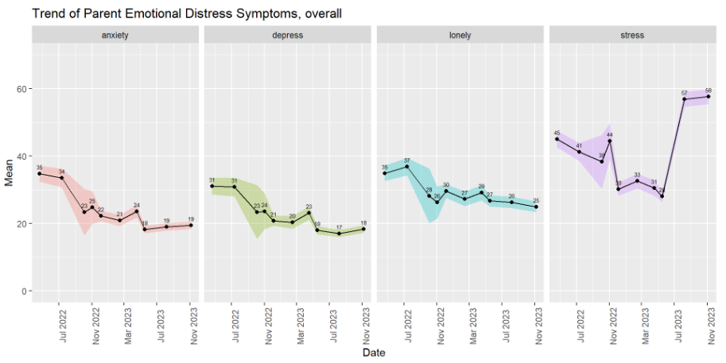
RAPID-fsk: parent emotional distress symptoms

Slide 23
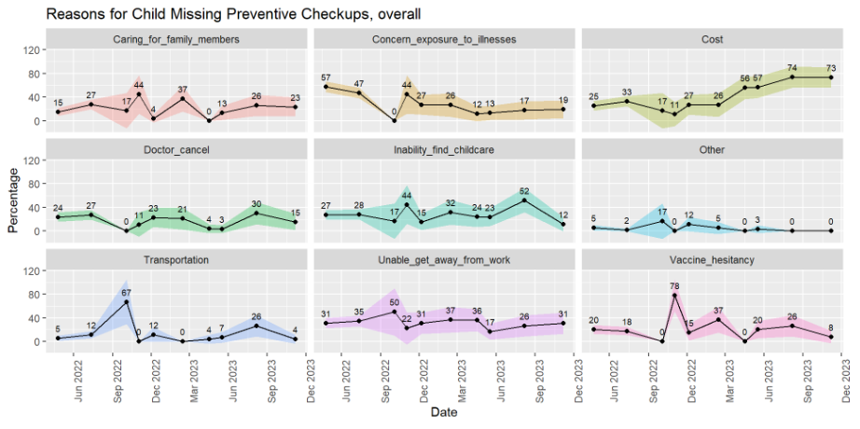
RAPID-fsk: reason of missed child preventive checkups

Slide 24
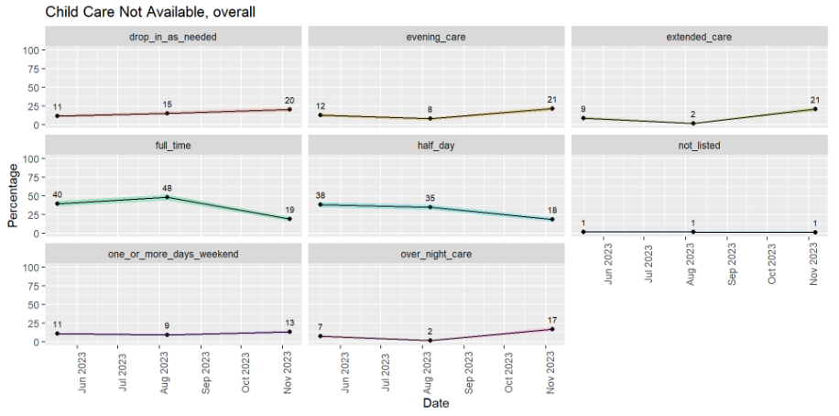
RAPID-fsk: child care not available

Slide 25
Thank you questions & feedback

