Slide 1


READY BY FIVE MILLAGE – REQUIRED DATA AGREEMENT INFORMATION
APRIL 15, 2020

Slide 2
Evaluation Overview

Slide 3
How Service Providers Funded by Ready by Five Will Impact K-Readiness
  Ensuring services are reaching and successfully engaging our most vulnerable families
  Increasing the frequency in which young children are screened to identify developmental concerns early
  Supporting healthy births
  Increasing the frequency of which young children are screened for lead poisoning, especially in areas where lead poisoning is common
  Ensuring all children who are identified having a high lead level receive supports and evidence-based interventions to remove environmental and health risks
  Increasing completion of all well child visits (a proxy measure of immunizations is used)
  Eliminating and addressing barriers to access of services families are referred to or request services from
  Showing program’s impact and effectiveness with parent education and support
  Increasing cross-sector collaboration between providers

Slide 4

This Photo by Unknown Author is licensed under CC BY-NC-ND
Notes:
Ultimately, what we want to be able to show is that children in Kent County served by Ready by Five Services are better prepared for Kindergarten!
We are working on the long term evaluation component of Ready by Five. What we would like to do is link child-specific data that you agency submits to the Kent County Health Department to K-readiness assessments housed at the Kent ISD.
It is important that all Ready by Five Service Providers are requesting consent upfront from parents to do this. We will walk through this later in the presentation.

Slide 5
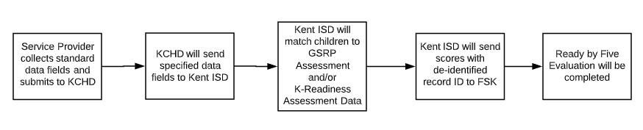
Linking to K-Readiness Data
Notes:
As agreements are put into place, this is what we would like to see happen with Data.
All children served by Ready by Five will be sent to Kent ISD’s database to be linked to K-readiness information.

Slide 6
Finalized POLICIES
Notes:
FSK has waited until details have been finalized to release updates to help reduce confusion with multiple versions being distributed.
This has take a little longer with our partners at the Kent County Health Department because of COVID. Many of you are aware the planning for what is unfolding today as far as COVID response in our community has taken months of preparation by the Health Department.
Understandably, finalizing data agreements has taken longer than anybody would have wanted for these reasons.
Also,
We have considered feedback from Service Providers we received during new provider orientation meetings.
We are going to present on the two Policies that are key to this data work.

Slide 7
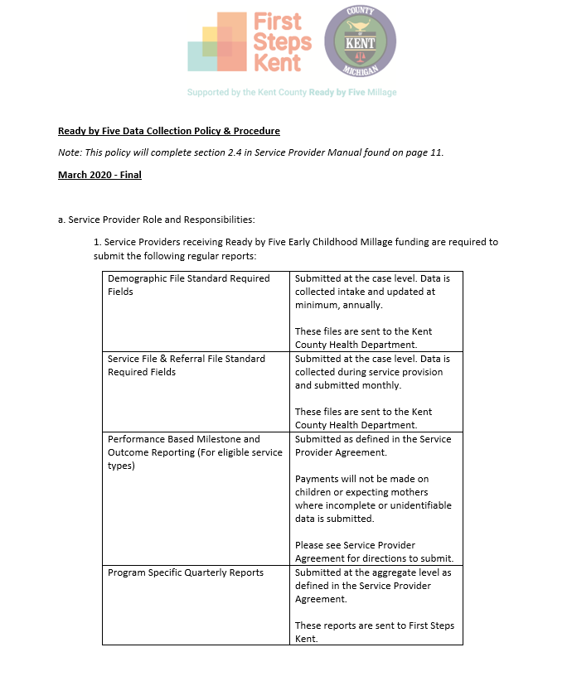
Ready by Five Data Collection Policy & Procedure (1 of 2)
Finalized since Service Provider orientation sessions.
  Clarified required reporting requirements
  Defined roles and responsibilities for Health Department, Service Provider and First Steps Kent
This Policy completes Section 2.4 in the Ready by Five Service Provider Manual (page 11)

Slide 8
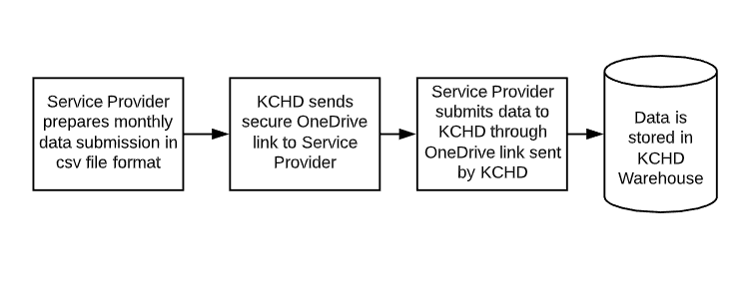
Ready by Five Reporting
Quarterly Reports (Next report due on July 15, 2020)
  Sent to Christine Timbol-Larson on a quarterly basis
  Report on program-specific metrics as outlined in Service Provider Agreement, Exhibit A
  Submitted in Excel
  These reports do not contain identifiable data
Monthly Data Submission
  Sent to KCHD on a monthly basis
  Individual-specific data as defined in Ready by Five Data Documents
  Submitted in .csv file via secure OneDrive link provided by KCHD
  These submissions do contain identifiable data
Notes:
There are different reporting categories:
Quarterly reports that do not include identified data – these metrics are included in Exhibit A, Scope of Work in your Service Provider Agreement.
The quarterly reports are sent to Christine every quarter.
2) The individuals served (specifically children and expectant mothers)
The information presented today is relevant to the second type of reporting – individual data of children and expectant mothers your agency serves.
The monthly submissions are sent to Kent County Health Department vis the secure OneDrive link sent from KCHD.
3) Let’s mention invoices – there is the monthly invoice for the unit rate
There is an additional invoice form for milestone payments. This is for submitting for payment only – not data. There is webinar information posted on the Millage Portal if you need more information about forms used to invoice.
We know with COVID, data is sparse. This will change once programs are up and running!

Slide 9
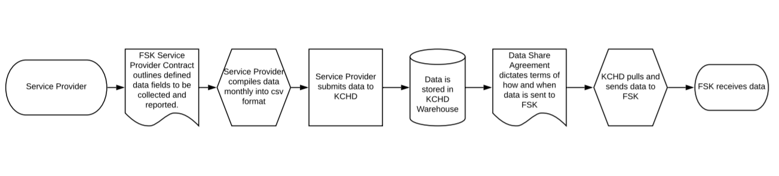
Ready by Five Data Collection Policy & Procedure
2. Service Providers shall enter into data sharing agreements as directed by Kent County. On a monthly basis, the Service Provider shall submit child or expectant mother-specific information to KCHD, as follows:
Data will be submitted at a case level.
All Standard Required Fields will be submitted in the defined format as detailed in Ready by Five’s Standard Data Collection Fields Requirements document.
All technical requirements for the data files as found in the Ready by Five File Definitions document.
Data will be submitted in a Comma Separated Values (CSV) file.
Identifiable data will be sent via a secure file transfer process and only as directed.
Under no circumstances will identifiable data be sent to First Steps Kent.
Notes:
Documents referenced can be found on the Ready by Five Millage Portal

Slide 10
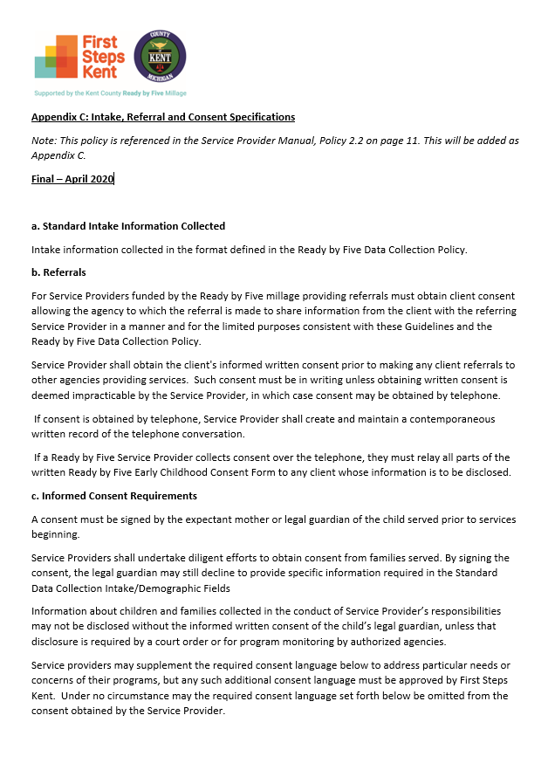
Appendix C: Intake, Referral and Consent Specifications (1 of 2)
This Policy has been updated since Service Provider orientations.
This policy covers:
  Standard intake information is defined in the Demographic File Standard Required Fields and Service File & Referral File Standard Required Fields (these documents are available on the Millage Portal).
  Referrals must have documented consent prior. FSK has standardized this language in consent language for all services.
  Informed Consent Language cannot be modified. Additional language was added to comply with Kent County Health Department Data Agreement requirements and for evaluation purposes.
  Privacy Notice was developed for Ready by Five only. This does not replace additional requirements of Service Provider disclose how their agency will use and disclose data.
Notes:
We grappled with this a lot.
In our earlier edition, we kept things as simple as possible.
Based on feedback during orientations, we heard it needed to be more comprehensive
and we heard the majority of service providers will be referring out in all the services. (This was wonderful to hear!). We want to be sure everyone is covered as they provide referrals.
Also,
In order to link data, there needs to be specificity in our disclosure to families.
Because of the evaluation, we do not have the flexibility to modify this language for each service provider.
We waited to make changes until the Data Agreement piece was finalized.

Slide 11
Appendix C: Intake, Referral and Consent Specifications
The Consent Language is between the Service Provider and family, and gives permission to the Service Provider to:
  Send identified data to Kent County Health Department
  Discloses where data is being sent and how it will be used
  Collects consent for Service Provider to offer referrals, as needed
  Explanation of how consent can be cancelled
  Note: Informed consent language is different for each type of service
Service Provider must obtain consent before a individual’s data can be sent to Kent County Health Department

Slide 12
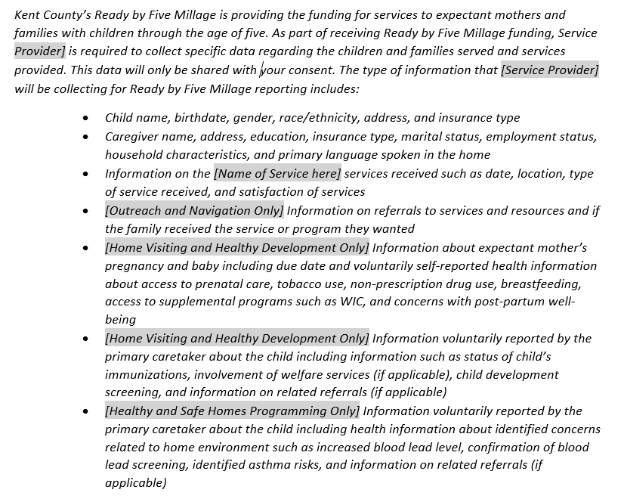
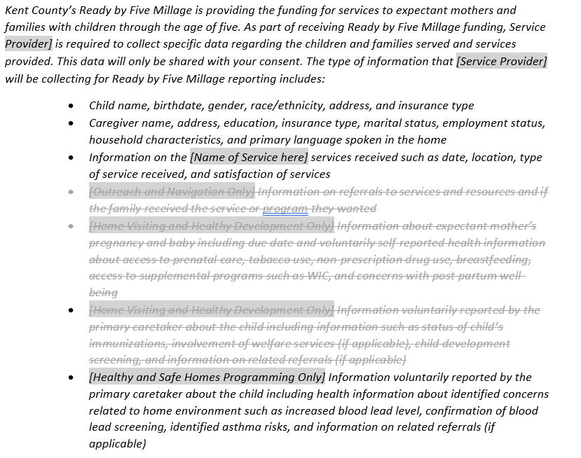
Appendix C: Intake, Referral and Consent Specifications - Example
Healthy and Safe Home Programming language would include only the following:
Notes:
You will see in the consent language notes about language that is required for Outreach and Navigation only or Healthy and Safe Homes programming only.
If there is not a note about the language being optional, it is required.

Slide 13
Appendix C: Intake, Referral and Consent Specifications
Service Providers may:
  Integrate this language into their current consent process.
  May consider including an option (i.e. checkbox) for staff to select if families opt out of sharing data
FSK has provided a notice that clearly explains how data will be collected, shared and used.
  This Privacy Notice must be provided to all families enrolled in Ready by Five funded services
  The Privacy Notice will be posted on the First Steps Kent website for families to access
FSK will provide consent and Privacy Notice translated in Spanish (by the end of May)
All materials will be available on the Ready by Five Millage Portal
Notes:
Again, Service Provider must obtain consent before a individual’s data can be sent to Kent County Health Department

Slide 14
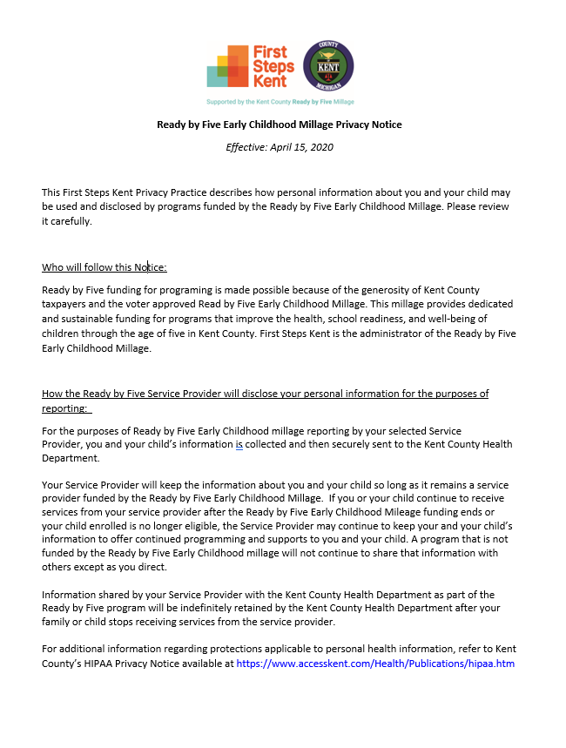
Ready by Five Privacy Notice
Included in Appendix C: Intake, Referral and Consent Specifications
Additional detail on how data will be used and shared, including:
  When a Service Provider will retain and use data once individual is no longer participating in services
  How data will be stored at Kent County Health Department
  Data that will be shared with Kent ISD
  Data that will be shared with First Steps Kent
  How data will be used

Slide 15
Data Agreements

Slide 16
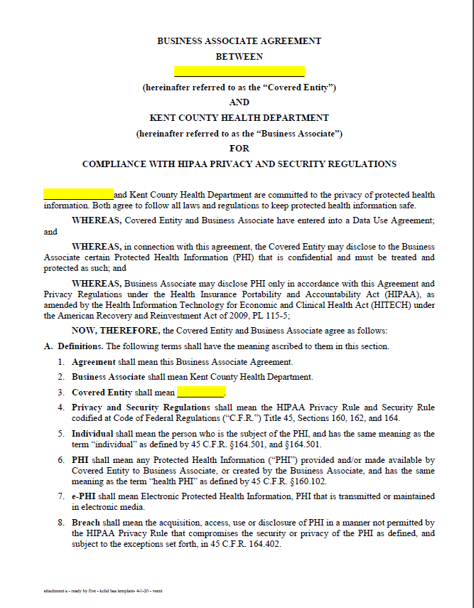
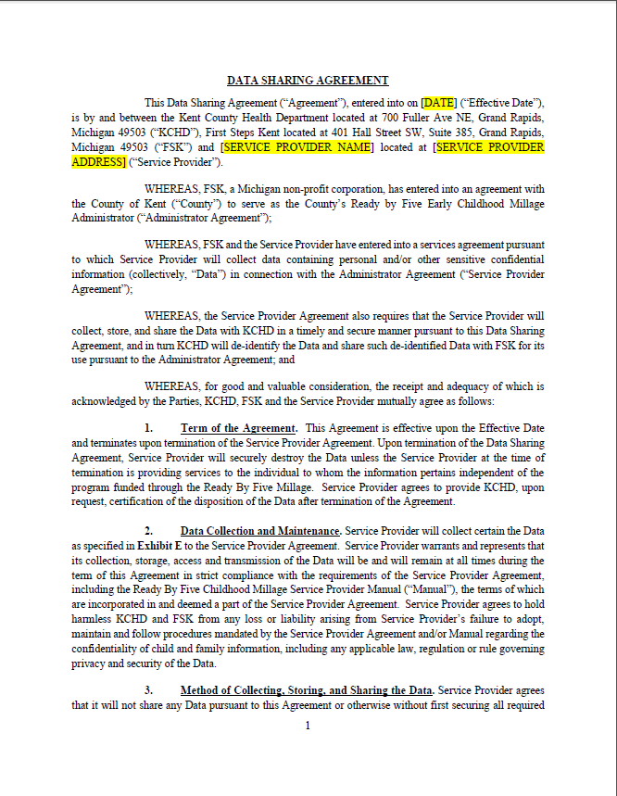
Data Share Agreements
Ready by Five BAA Template
Ready by Five Data Agreement

Slide 17
Data Share Agreements
Data Share Agreements will be implemented with Service Providers using the documents as outlined below:
For Service Providers who are Covered Entities under HIPAA | For Service Providers who are Non-Covered Entities
Service Provider will utilize Ready by Five BAA template as provided by FSK. | Service Provider will utilize Ready by Five Data Agreement provided by FSK. No BAA is required.
Note: Service Providers will be responsible for determining which type of agreement is appropriate for their organization.
Notes:
Review by Service Provider legal council is advised by FSK prior to Service Provider signing.
We will send both documents to everyone on today’s call.
You only need to submit one of the documents.

Slide 18
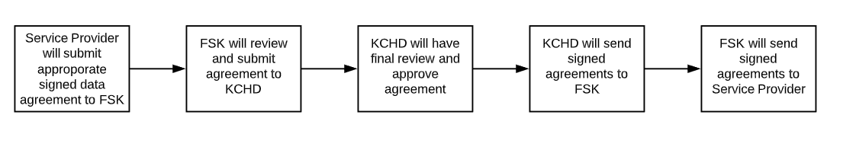
Agreement Submittal Process

Slide 19
Implementation – Important deadlines
Data Agreements
  Service Providers will review and sign by May 15, 2020 – EARLIER IF POSSIBLE!
  Electronically send signed agreement to Ready by Five Email - ReadybyFive@firststepskent.org
Consent Language
  Asking Service Provider to have this in place by May 29, 2020
  If implementation is not possible by this deadline, you must notify First Steps Kent
  Reach out to Tyler Aman with any questions – taman@firststepskent.org
Notes:
Sign the correct type of document and submit to Ready by Five.
Remember, You only need to submit one of the documents depending on if you are a covered entity under HIPAA or not.

Slide 20
Implementation – Important deadlines
By May 15, 2020 | By June 5, 2020 | By June 15, 2020
Service Provider will submit signed Data Agreement to FSK | Data Agreements will be executed by KCHD | Service Provider will submit monthly data to KCHD vis secure submittal process.
First Monthly Data Submission to Kent County Health Department
  It is time to begin to prepare data for submission!
  Aiming for all Service Providers to complete first data drop with KCHD by June 15, 2020.
    Please note: this is conditional on the COVID situation and KCHD’s availability to execute Data Agreements in time.
  Submit data only once Data Agreement has been fully executed with Kent County Health Department
  Include individual-level data for all children and expectant mothers served since the beginning of your contract term for this initial submission.
    Subsequent submittals will contain one month of data
  Submit via secure link sent from Kent County Health Department (Neal Torren) in csv file (See Data Collection Policy)
  Reach out to Tyler Aman with any questions – taman@firststepskent.org
Notes:
All information will be posted on the Millage Portal
Also! Please complete the survey name and email of the person at your agency who should receive the secure email from Kent County Health Department to submit data. The link is in the material we sent out.

Slide 21

?
Will each partner with a subcontract in place need to have a data agreement in place or only the agency named on the Service Provider Agreement?
Please explain the process for developing the privacy agreements.
How long will the data that is sent be stored and who will have access to it?
Has or will the data holder be undertaking an IRB process?
What will be the process/protocol regarding families who do not want their data shared beyond the service provider?
What will be the process for families who want to withdraw their data after having made it available through their consent?
Notes:
Question about withdrawing data:
Also Neal one other quick question which we might have discussed before would be the character limit on Addresses, could that be increased to say 45 or 50 Characters?
I can increase the limit to 50, if that is helpful. Would you mind changing in file definition document, please?
Some providers were wondering if all the fields had to be submitted in the same order as listed in our sheets, based on our sheets I would say yes, but I wanted to confirm this.
You are correct that they have to be in the same order as the file definition document. Otherwise, I will not know which field is which unless they include a header row. Then I would have to make a different import for each provider which would complicate things a lot.
One provider had a question where their Record ID that they use for their system is delayed, so they would enter the child into the system and then the record ID they use in the system will be added later. Is there a way we can get around this or what do you think would be good for you to see on your end?
I am not sure what kind of delay they are talking about but we are using the Record ID as the main identifier for the record so I don’t think they should send the record without having the Record ID. It is also a required field and it would be more complex to follow the record without the Record ID. Let me know if this will cause big problems if they wait and this won’t work.
Another question that came up from providers was about the process for when a family decides they would like to revoke consent to give data, is there a process on the county’s end for data destruction?
What does it say in the document we gave them for the client consent? Did we say that we would delete it from the warehouse?
Here is a link that I believe is talking about HIPAA Privacy Authorizations and Revocations https://privacyruleandresearch.nih.gov/pdf/authorization.pdf It is possible but not desirable to take the information out of the warehouse, if we decide to do that. I believe that this section of the document supports having the provider stop sending the data but keeping it in the warehouse. I would imagine this will be rare so it would be a manual process if we do decide to take it out of the warehouse.
“A research subject may revoke Authorization at any time. However, a covered entity may continue to use and disclose PHI that was obtained before the individual revoked Authorization to the extent that the entity has taken action in reliance on the Authorization. In cases where the research is conducted by the covered entity, this would permit the covered entity to continue using or disclosing the PHI as necessary to maintain the integrity of the research, as, for example, to account for a subject’s withdrawal from the research study, to conduct investigations of scientific misconduct, or to report adverse events.”

Slide 22
?
Notes:
We will send materials to all individuals who registered for this session.
Complete the survey!
Materials will be posted on the Millage Portal.
Will be able to cover additional questions during Quality Improvement Consortium meetings coming up later this month

